Slide 1
Do-It-Yourself Factoid Discovery
Stan Dorn, Director, National Center for Coverage Innovation at Families USA
Notes:
NOTE: Make sure that the Title slide does not have footer information (sources, FUSA logomark and page number). To turn off on this page, go to Insert > Headers&Footers and deselect Footer and Page number options > Apply to this page only. Also, select start page numbers at 0.

Slide 2
The goal: finding numbers that answer specific policy-relevant questions
In my state, what are the characteristics of Medicaid beneficiaries who do not work?
What’s the age and income of my state’s uninsured who qualify for premium tax credits?
Nationally, how do health-care access barriers vary by race and ethnicity?

Slide 3
Easy-to-use federal data resources
Source | Survey | State | National
Integrated Public Use Microdata Series (IPUMS) https://ipums.org/ | American Community Survey (ACS)
 | Current Population Survey – Annual Social and Economic Supplement (CPS - ASEC)
 | National Health Interview Survey (NHIS)
Medical Expenditure Panel Survey (MEPS) https://www.meps.ahrq.gov/mepsweb/ | MEPS-Insurance Component (MEPS-IC)
 | MEPS- Household Component (MEPS-HC)

Slide 4
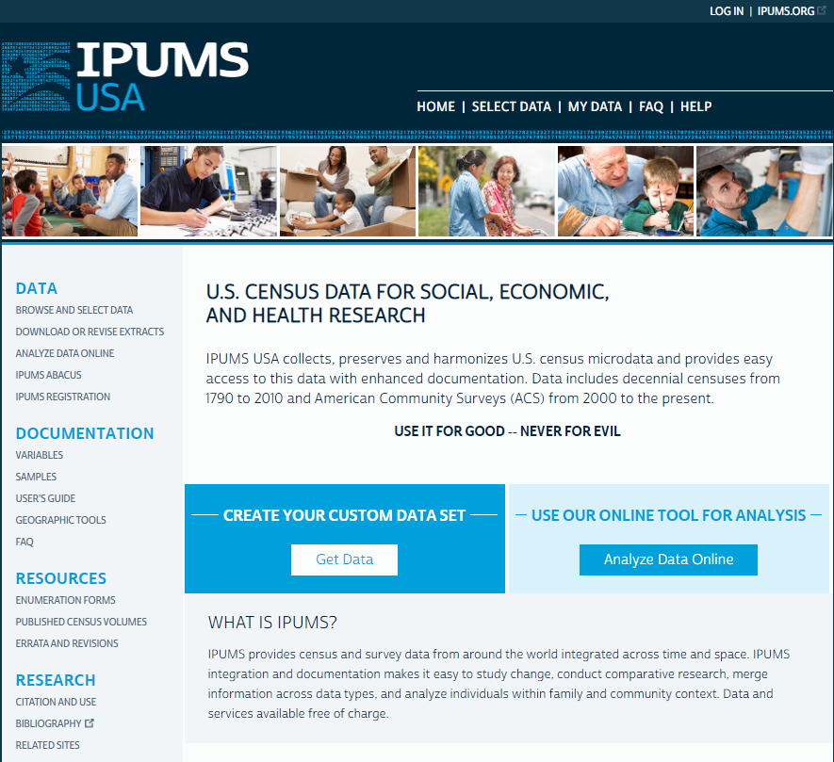
Front page: IPUMS for ACS

Slide 5
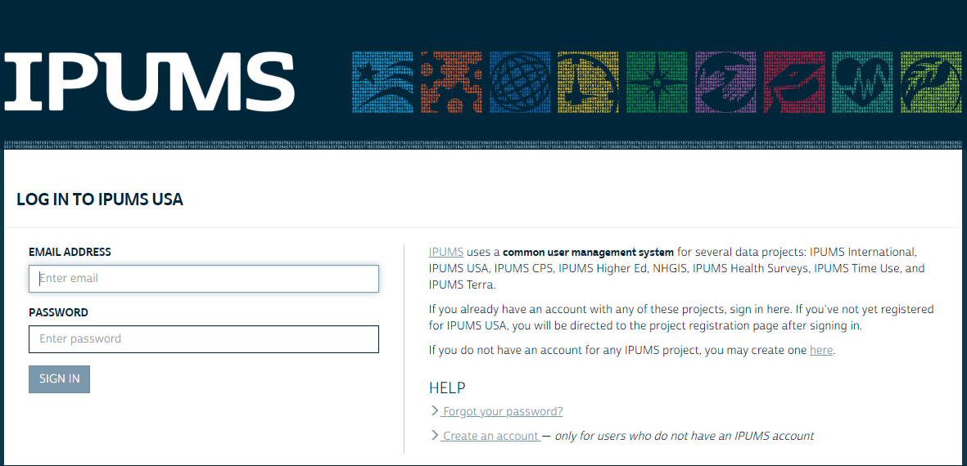
Log-in

Slide 6
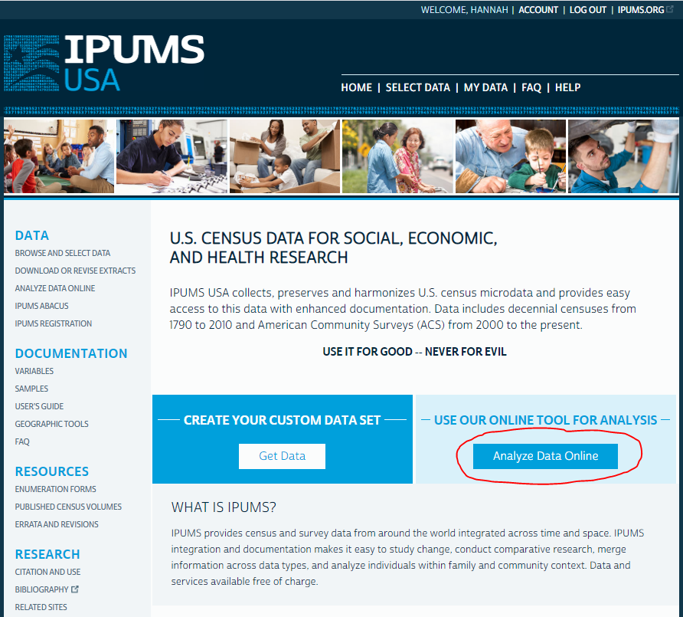
Accessing the data

Slide 7
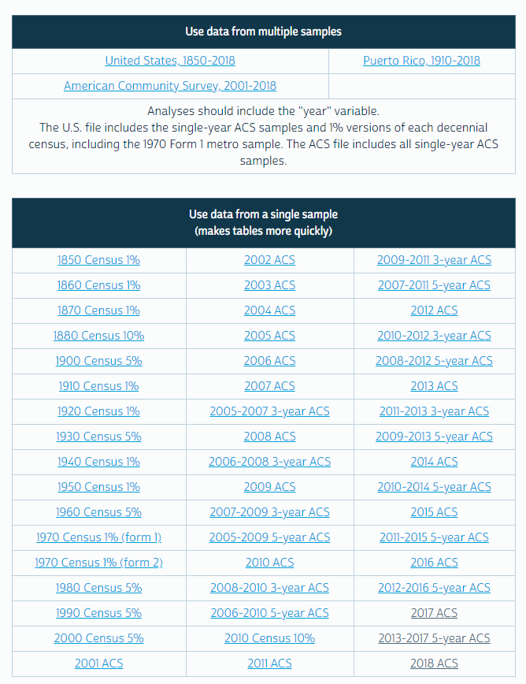
Picking the year(s)

Slide 8
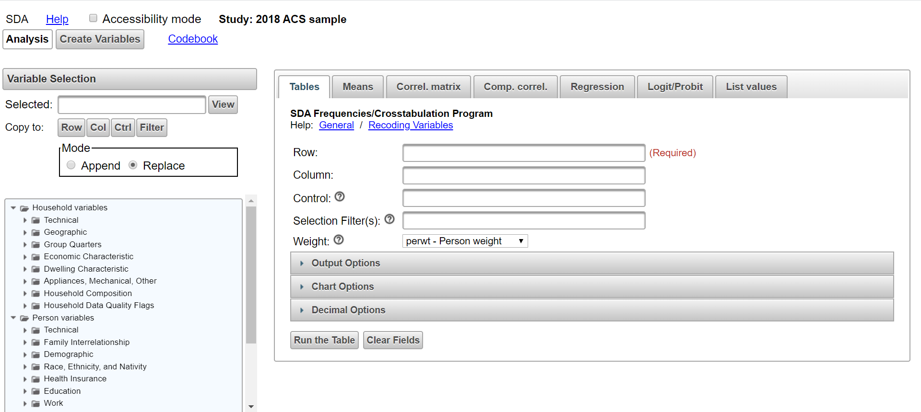
Now the fun part begins

Slide 9
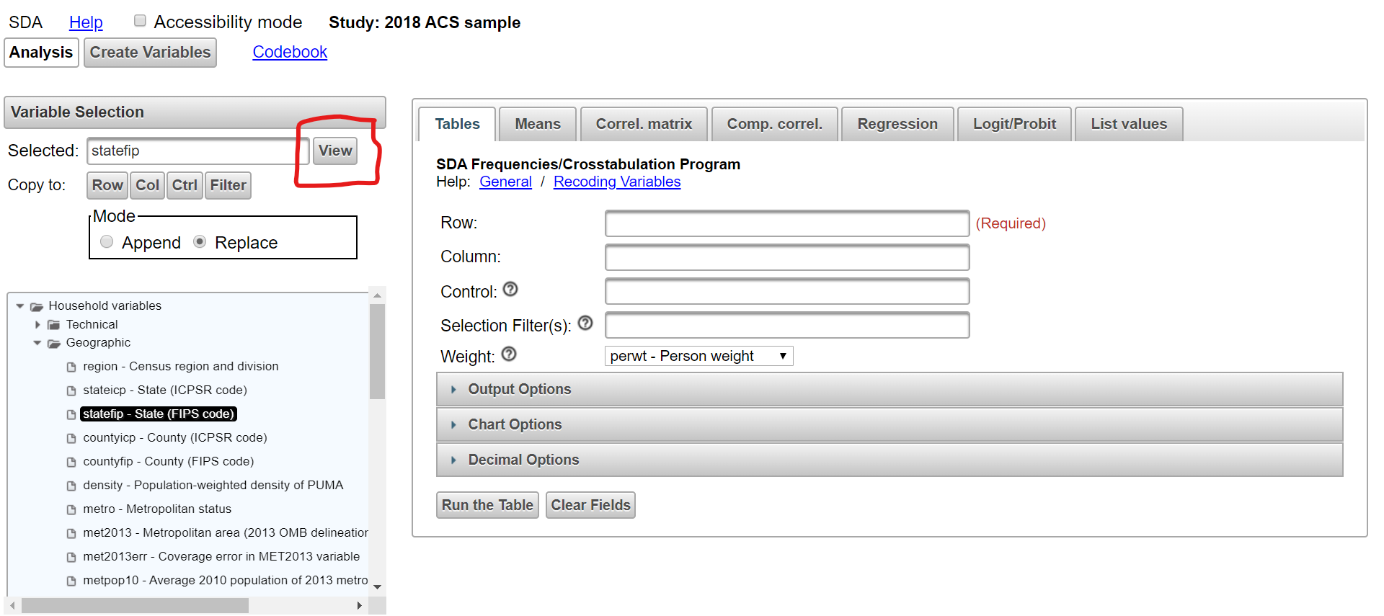
Let’s figure out who is uninsured in Illinois. We’ve picked the 2018 ACS results. First, let’s limit the data to people in Illinois. But which state is Illinois?

Slide 10
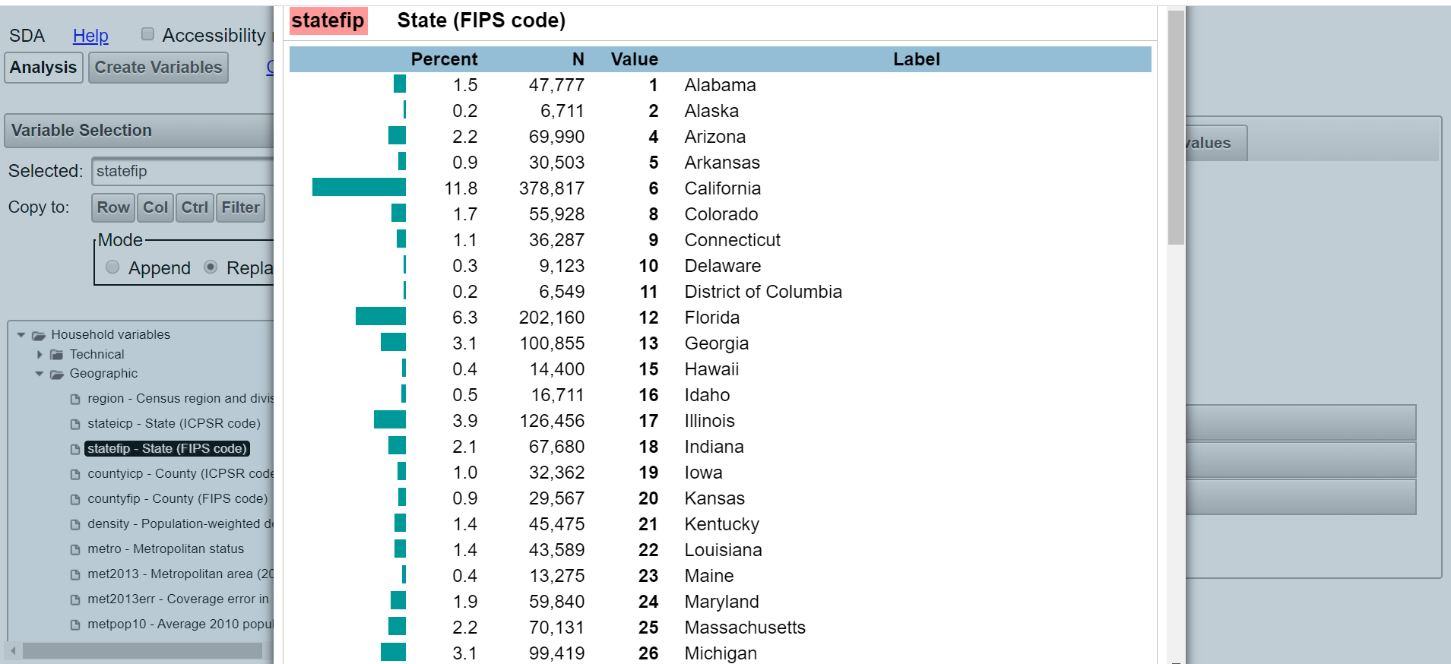
OK – it’s #17, using the FIPS code variable

Slide 11
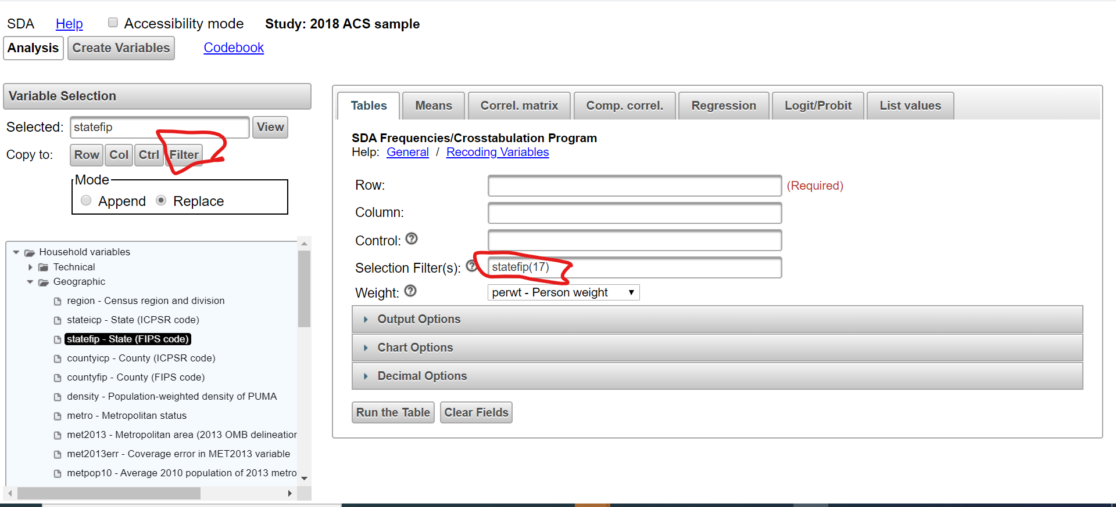
Let’s use the filter to limit the query to people in Illinois

Slide 12
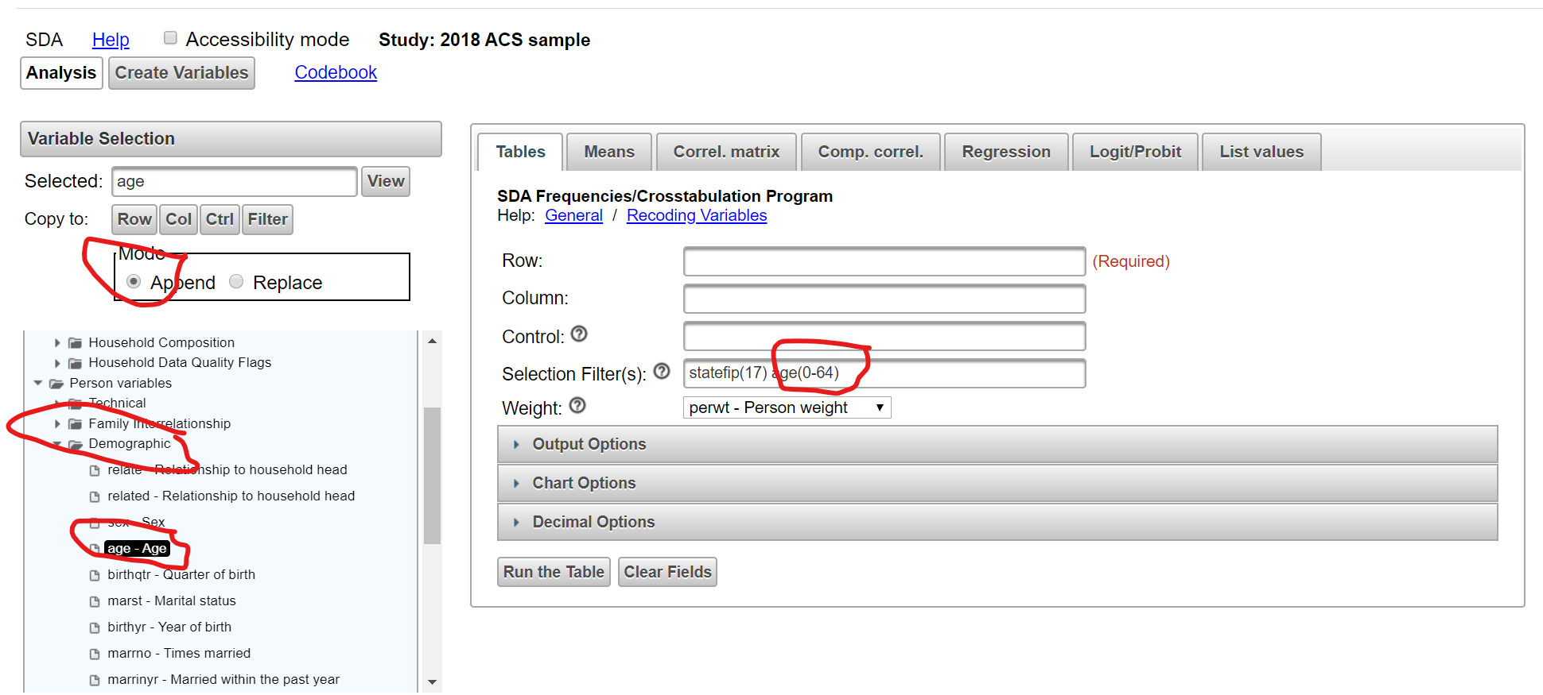
Let’s further limit the query to people under age 65

Slide 13
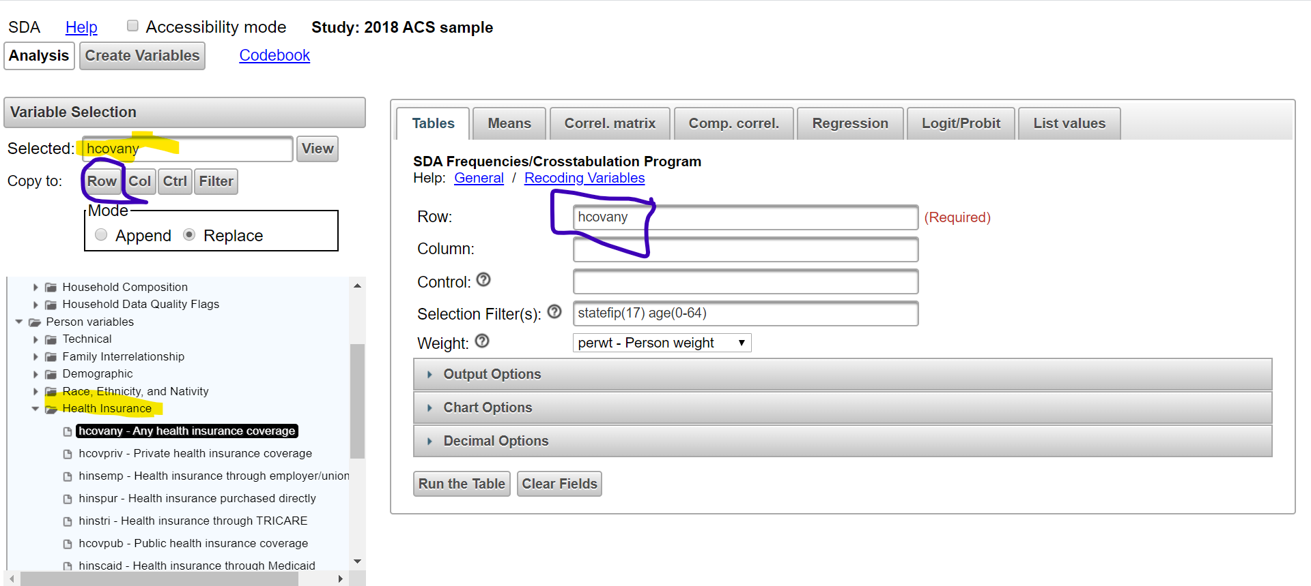
How many of them are uninsured?

Slide 14
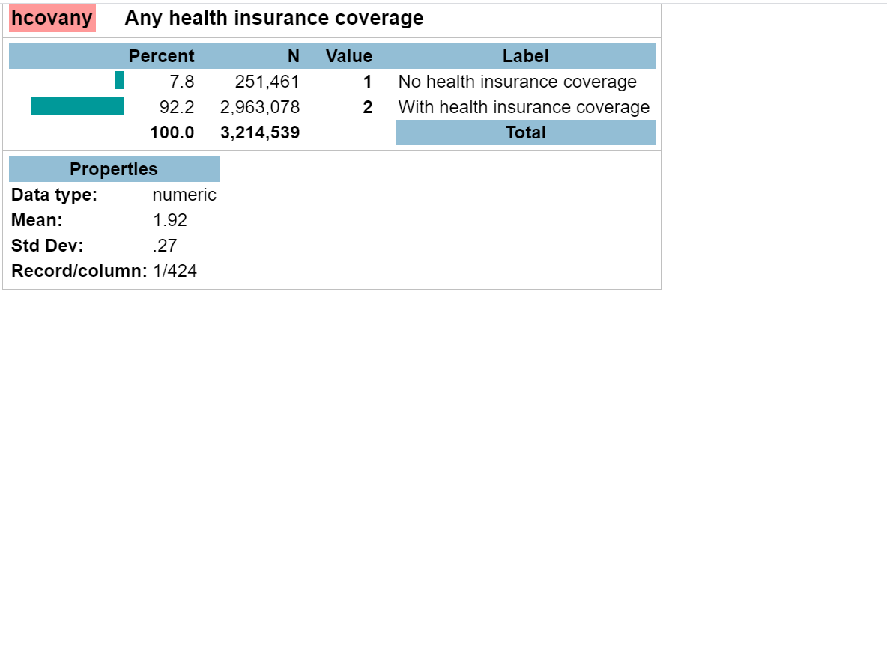
How many of them are uninsured?

Slide 15
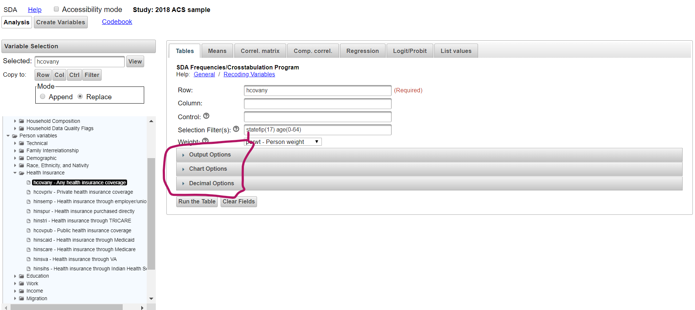
How do we want our results displayed?
Step #1

Slide 16
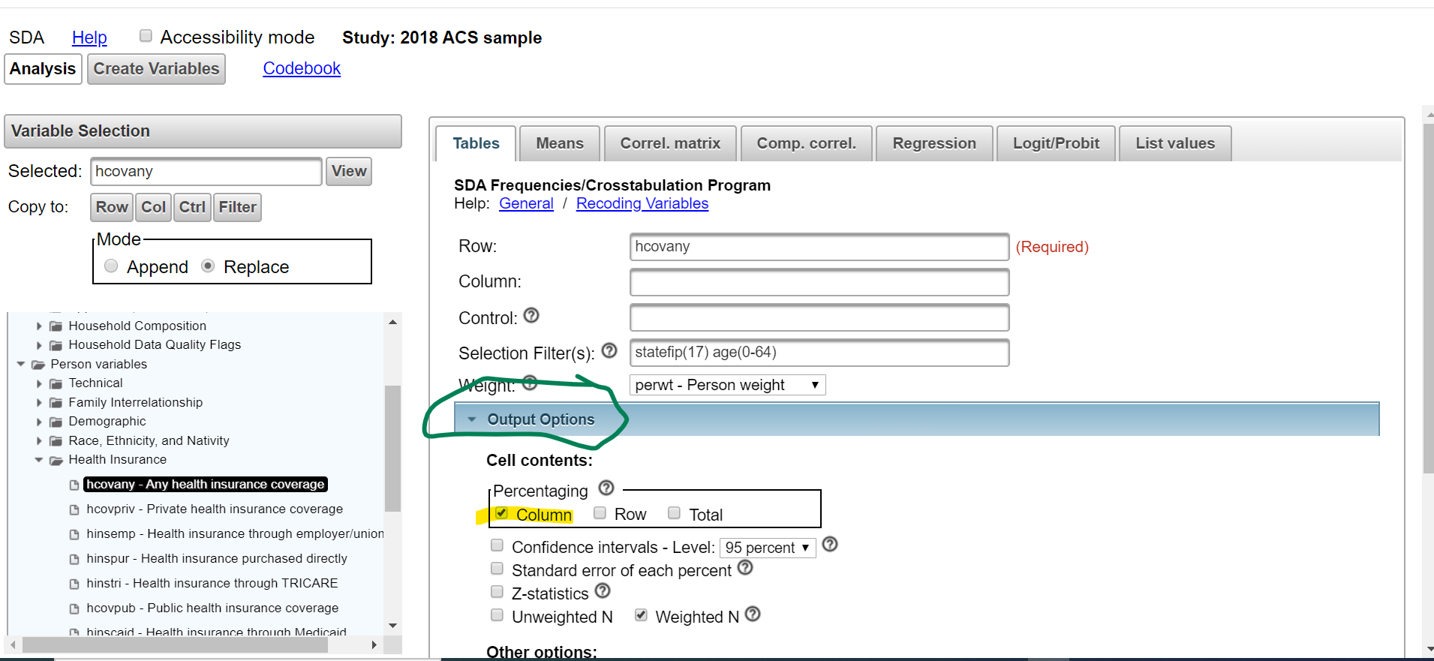
Let’s arrange our output

Slide 17
Let’s not do a chart
Step #2

Slide 18
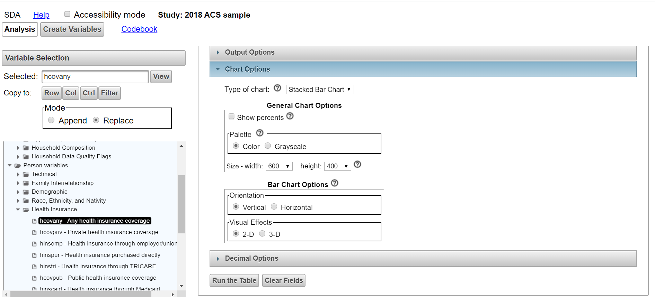
No charts

Slide 19
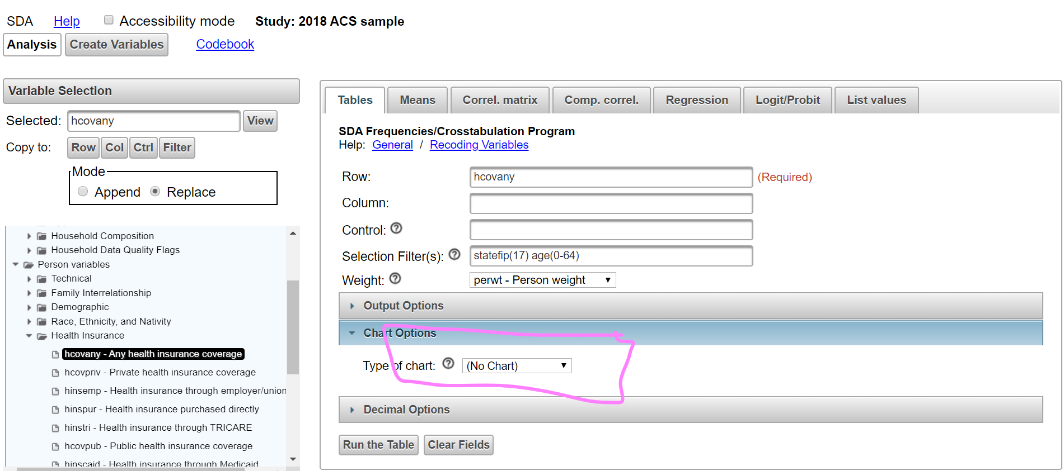
No charts

Slide 20
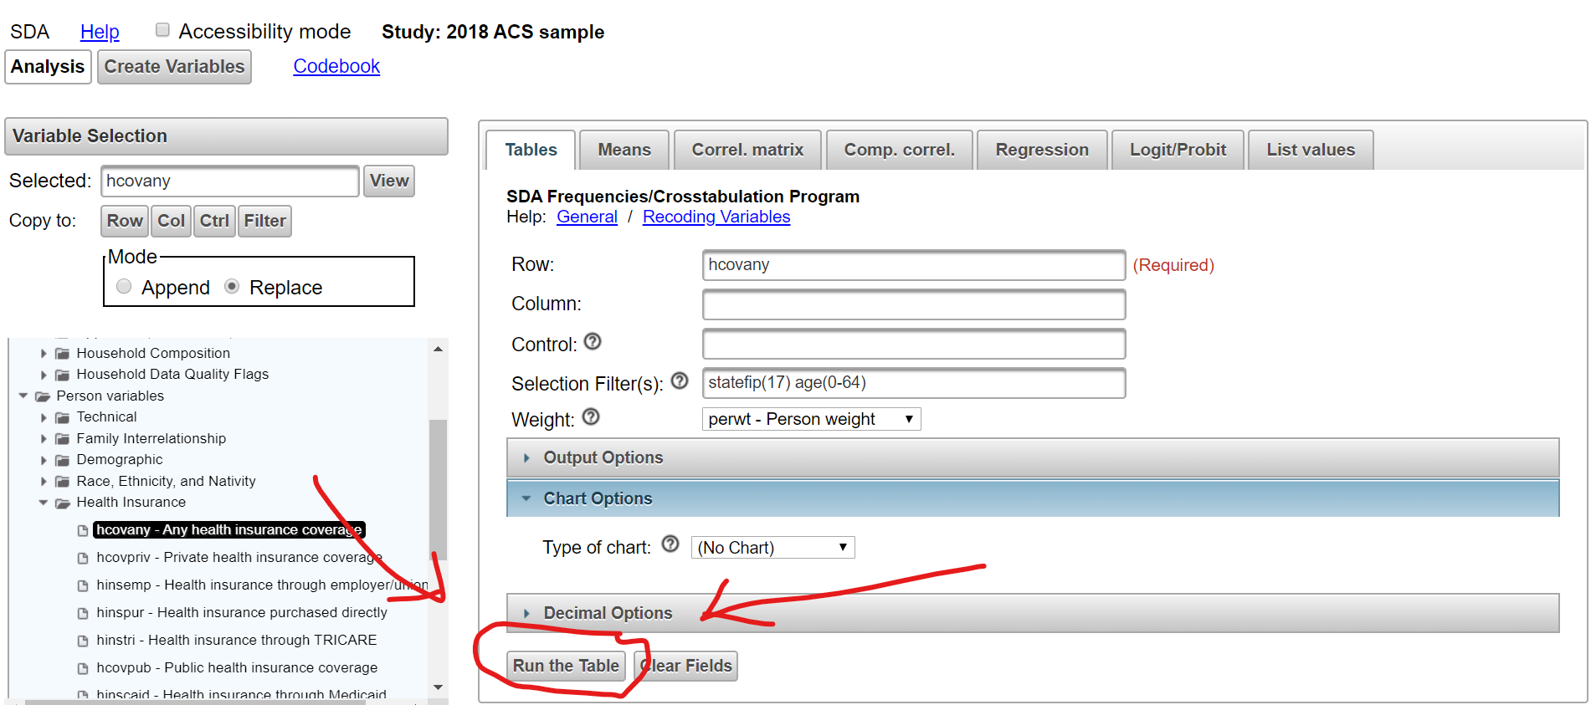
Now let’s run the table!!!!

Slide 21
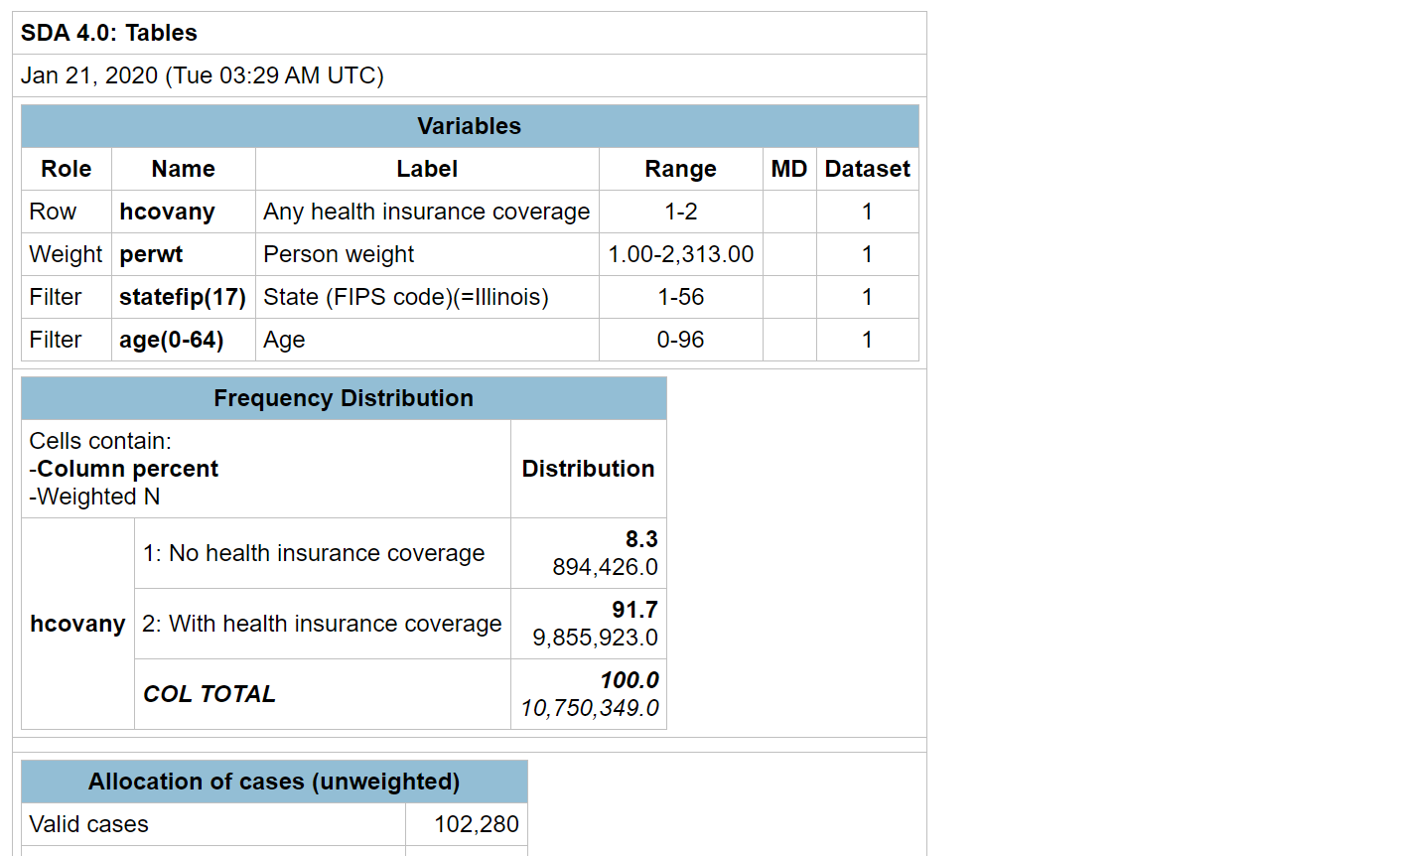
The results
8.3% uninsured
894,000 uninsured

Slide 22
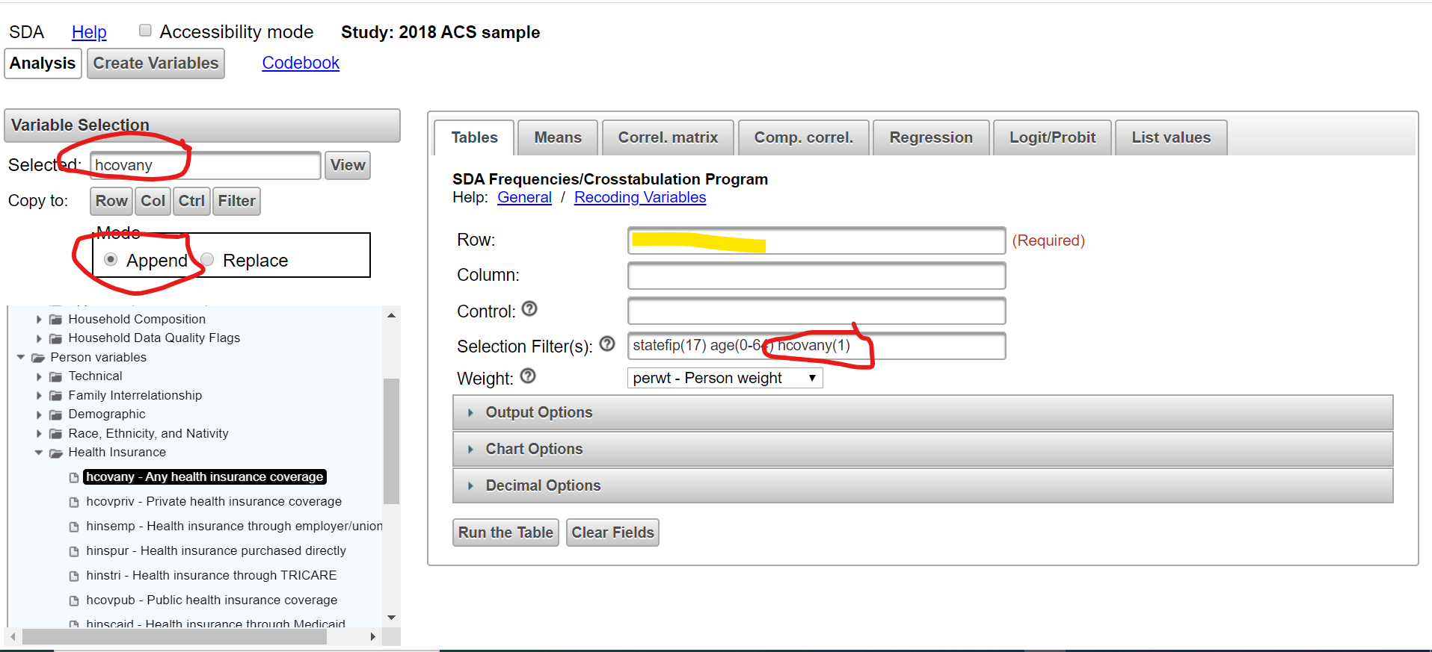
How are the uninsured distributed by age? First, let’s limit the data to the uninsured.

Slide 23
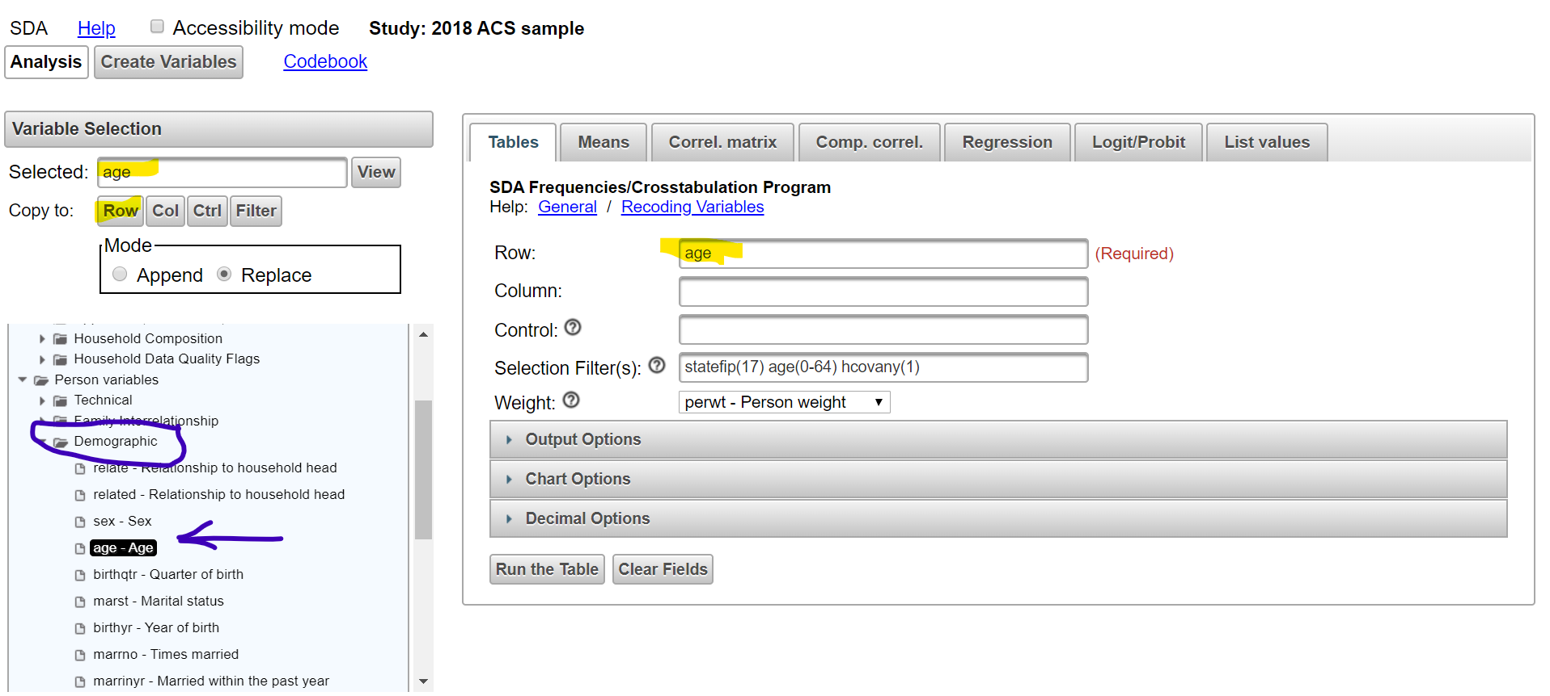
Now let’s see how the uninsured are distributed by age

Slide 24
Let’s run the table

Slide 25
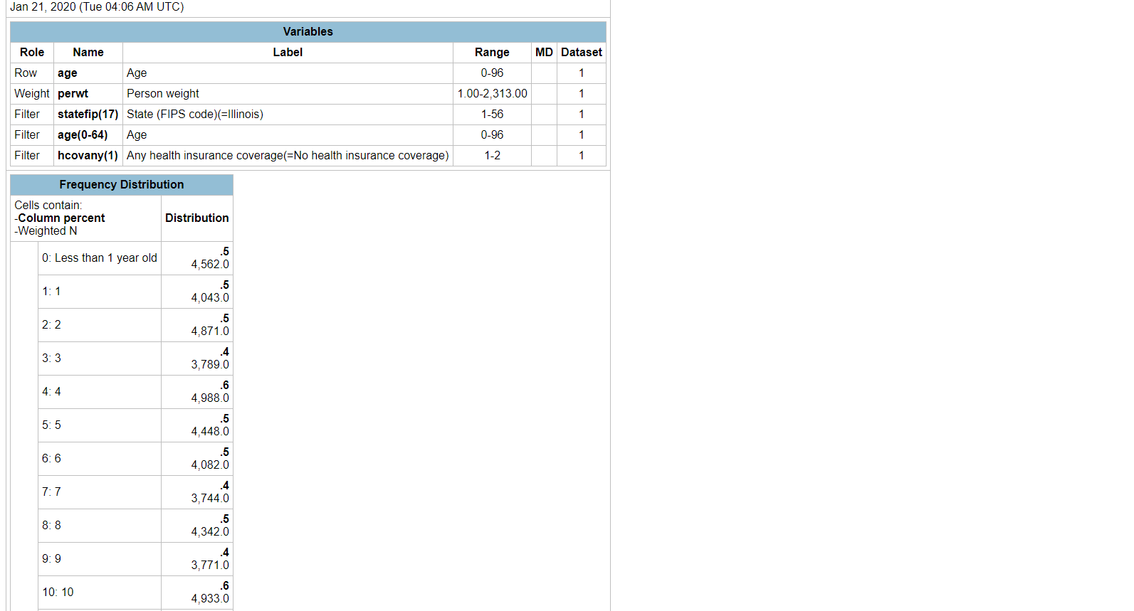
Results
Yikes!!! There’s got to be a better way!!

Slide 26
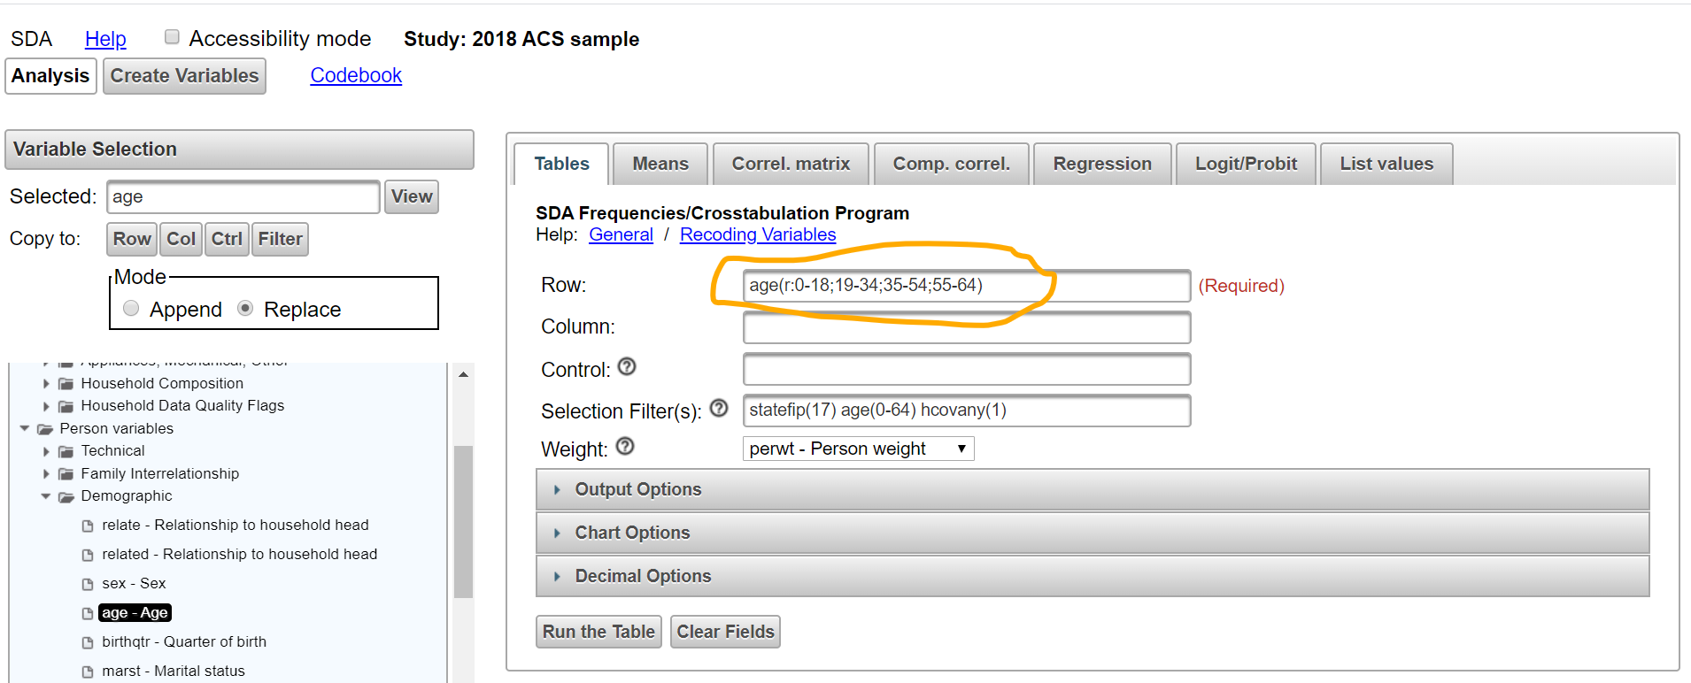
The magic of recoding: Organize variables into groups – in this case, age

Slide 27
Now run the table!

Slide 28
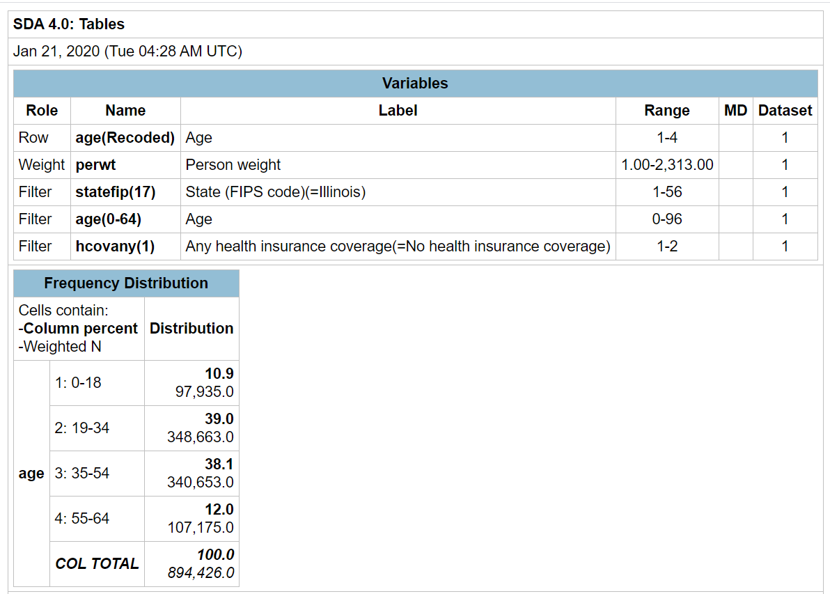
The results!
98,000 IL children are uninsured. They make up 10.9% of the state’s uninsured
349,000 young adults, age 19-34, are uninsured. They make up 39% of the state’s uninsured.

Slide 29
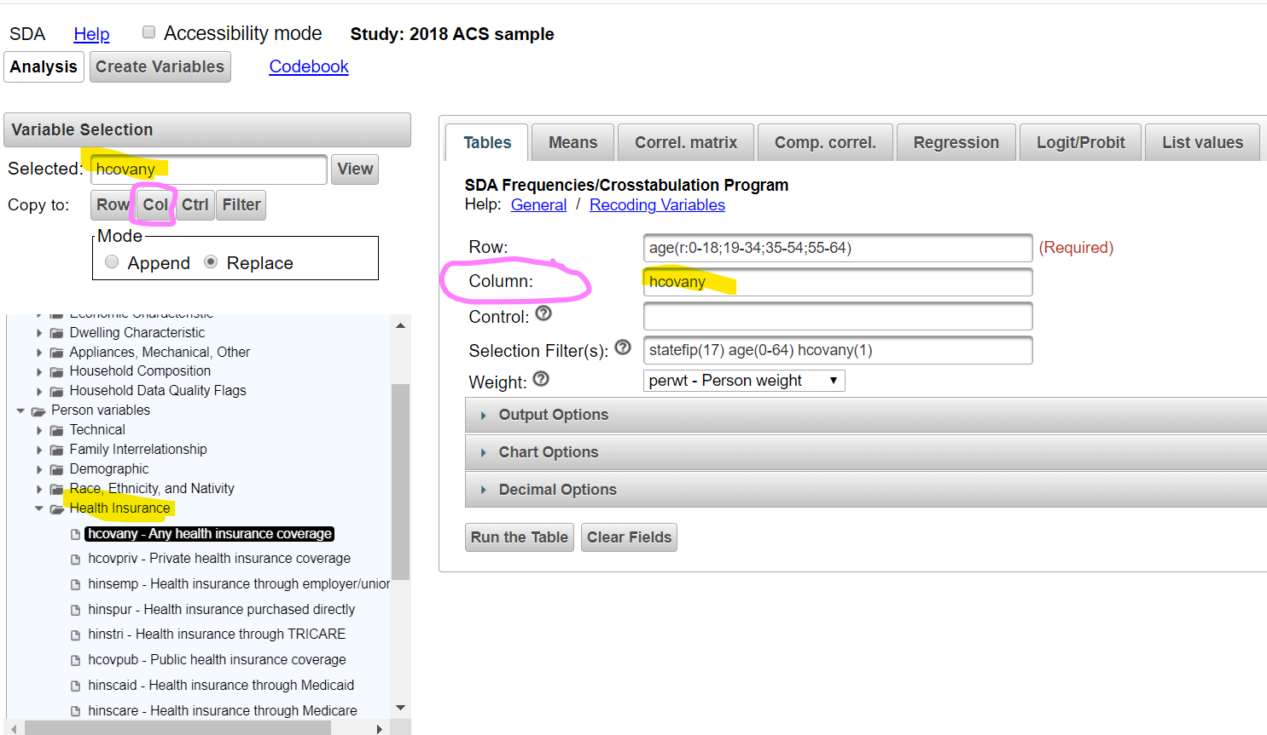
OK. But what percentage of Illinois residents in each age group are uninsured?

Slide 30
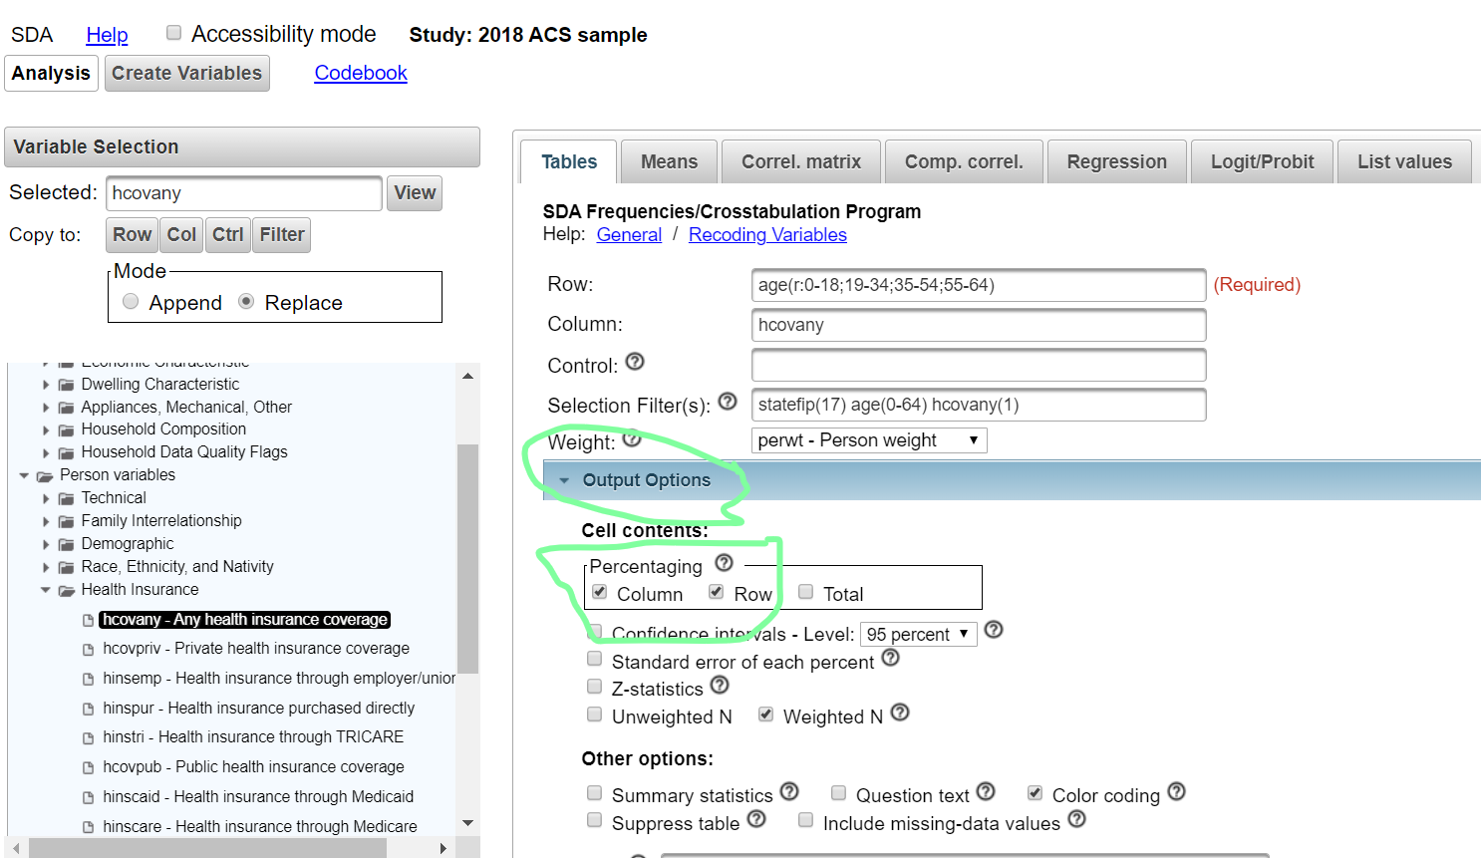
Let’s run the percentages both ways: row and column

Slide 31
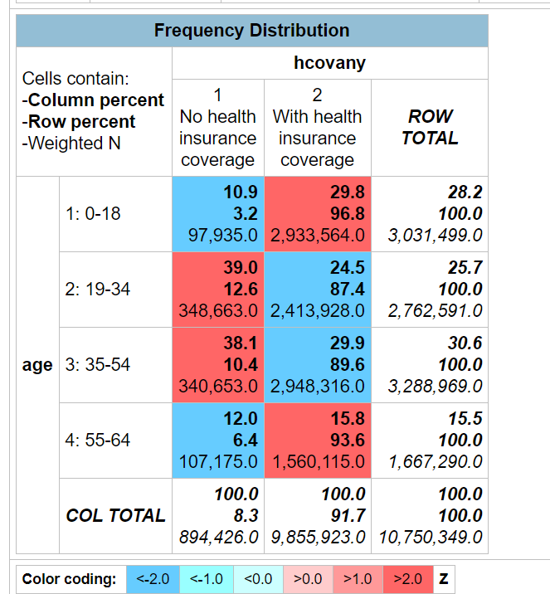
The results!
Only 3.2% of children are uninsured
Children comprise 28.2% of all non-elderly residents but
Only 10.9% of the state’s uninsured
12.6% of young Illinois adults – nearly 350,000 people – lack insurance
That’s more than 50% higher than the 8.3% uninsurance rate for all nonelderly residents
Nearly 2 out of every 5 Illinois uninsured (39%) are young adults, age 19-34, even though
They comprise just 25.7% of all nonelderly residents

Slide 32
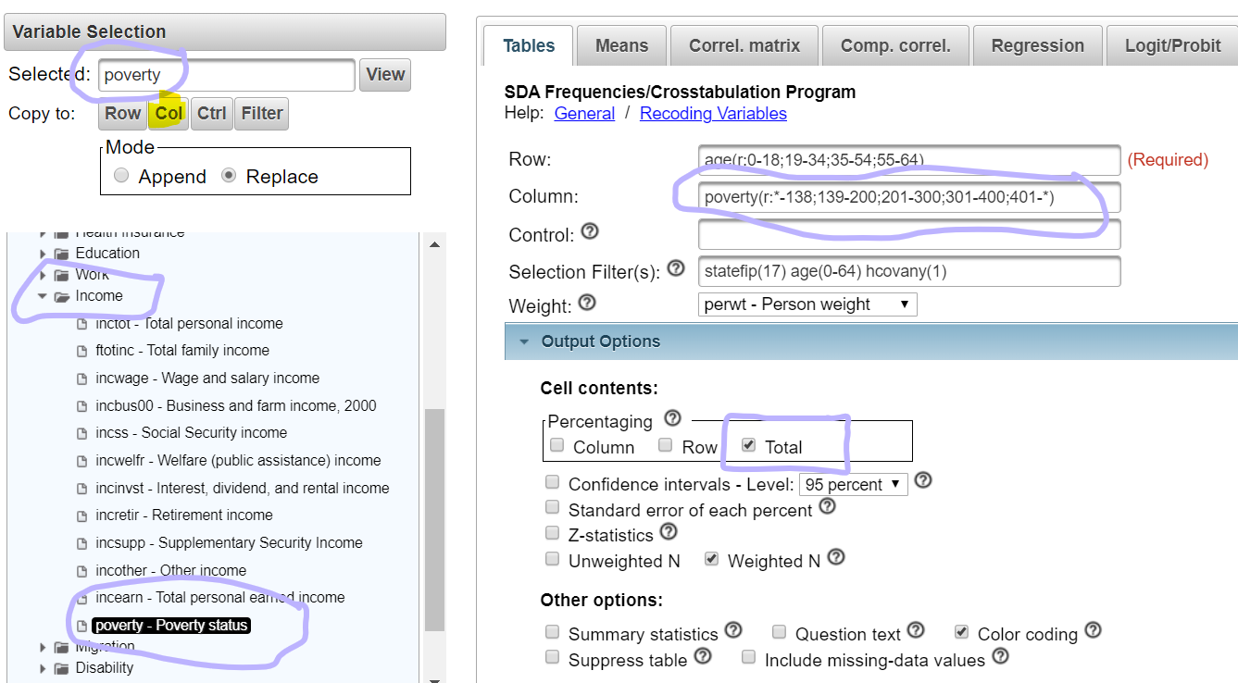
OK – how are the Illinois uninsured distributed, by age and percentage of the federal poverty level (FPL)?

Slide 33
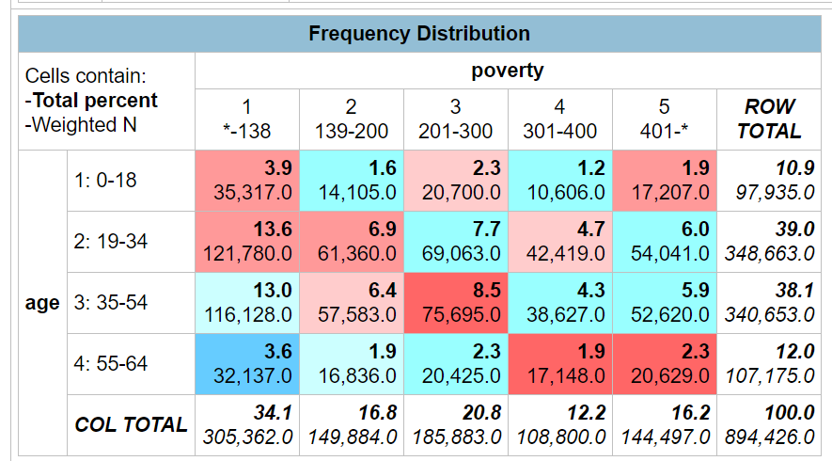
The results
More than a third of the state’s uninsured (34.1%) – 305,000 people – are financially eligible for Medicaid, with incomes at or below 138% FPL
Just 16.2% of the state’s uninsured are financially ineligible for any federal assistance, with income above 400% FPL

Slide 34
Copying the results into a spread sheet for further analysis

Slide 35
More spreadsheet magic
Source: American Community Survey, 2018.

Slide 36
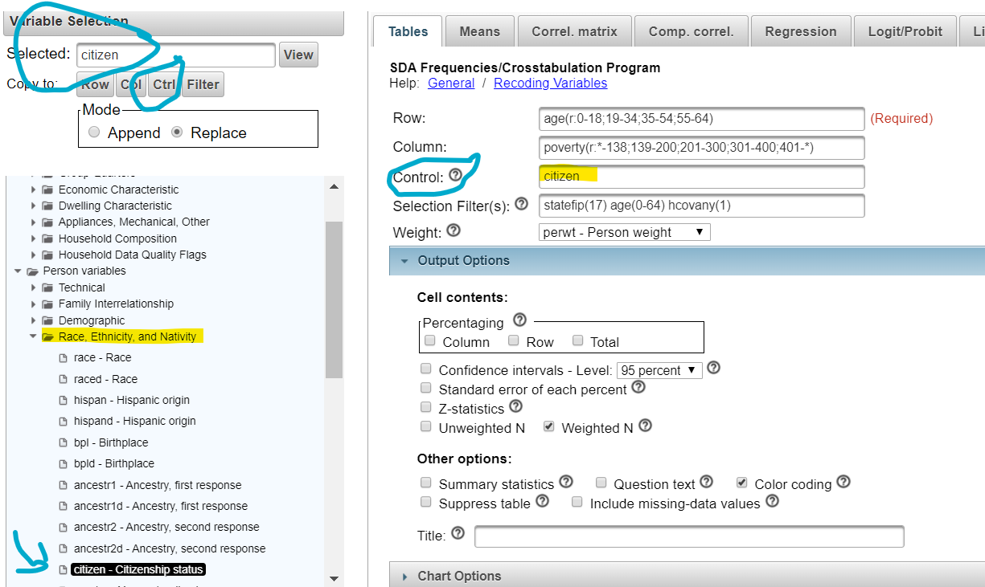
Extra credit: factoring in citizenship

Slide 37
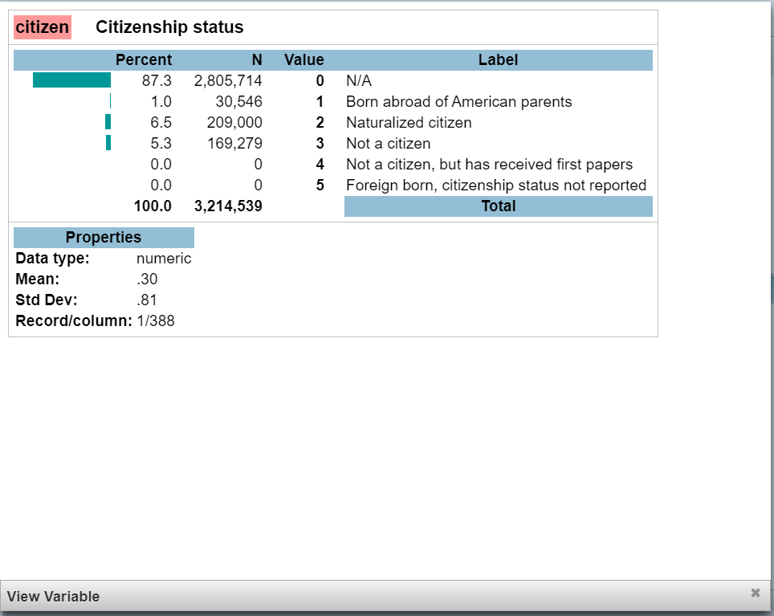
Extra credit: factoring in citizenship
Let’s recode:
0-2 is a U.S. citizen
3-5 is a non-citizen

Slide 38
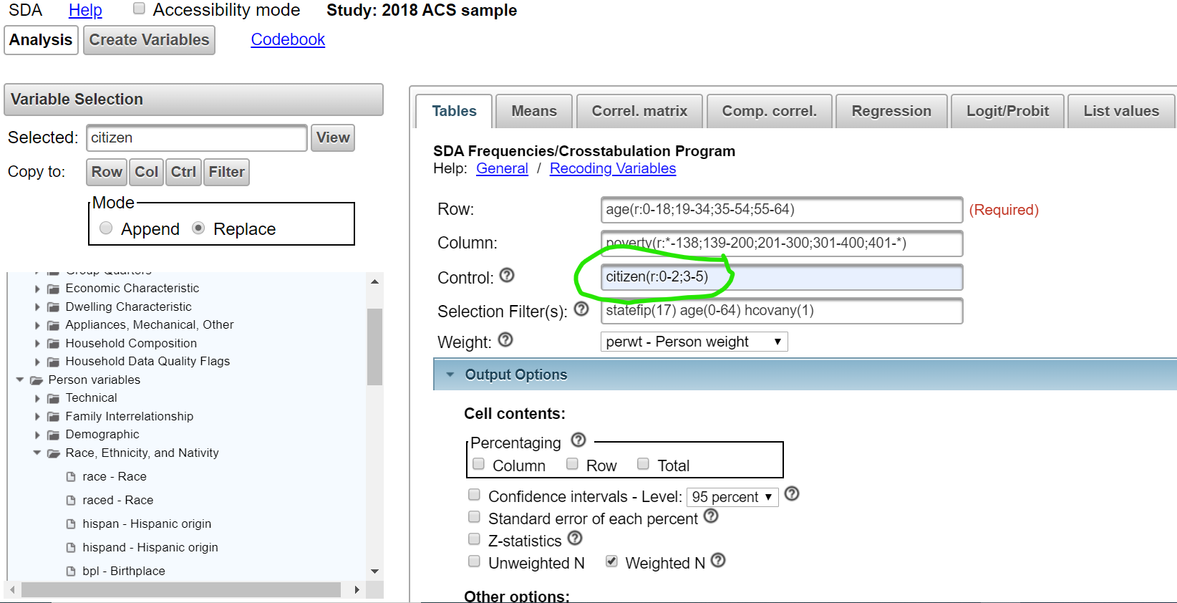
Here’s the citizen recoding

Slide 39
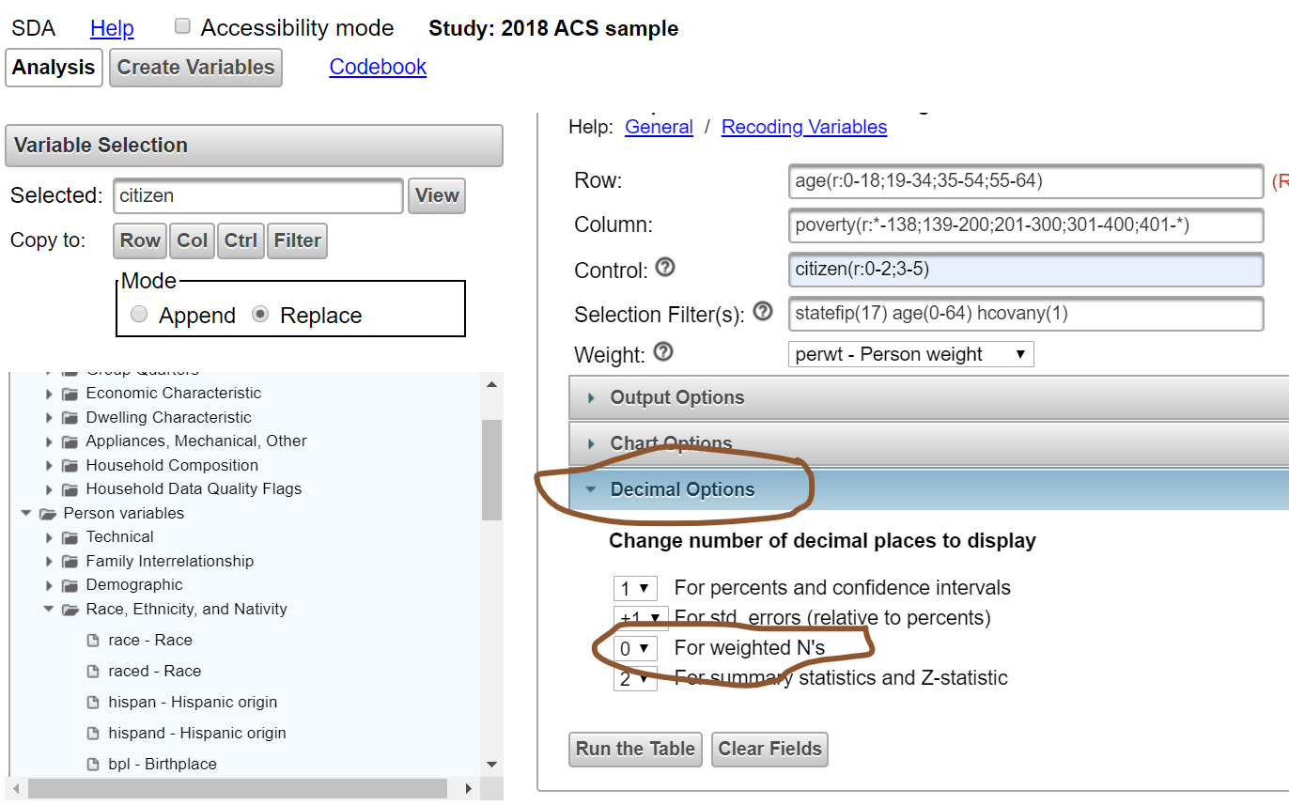
Let’s get rid of those stupid decimal points, all of which are 0

Slide 40
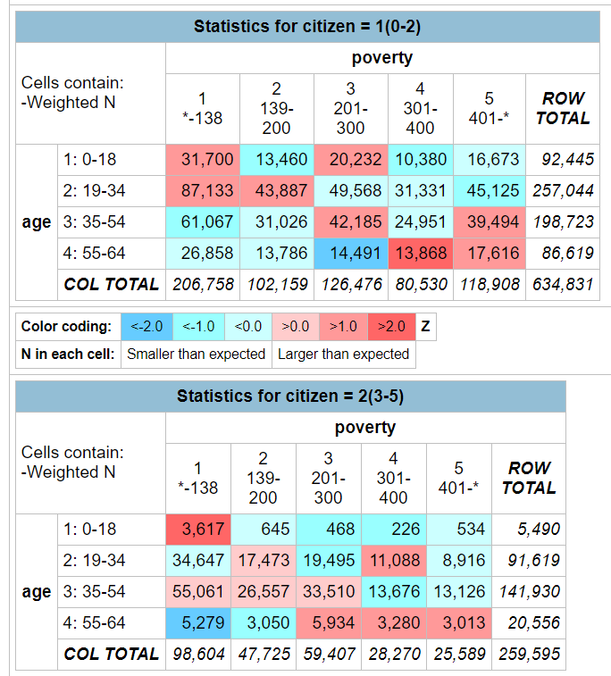
Results
More than 200,000 U.S. citizens in Illinois are eligible for Medicaid but not enrolled. They comprise nearly 1 in 4 (23%) Illinois uninsured.

Slide 41
Now it’s your turn!

