Slide 1
Families USA January 24, 2020

Slide 2
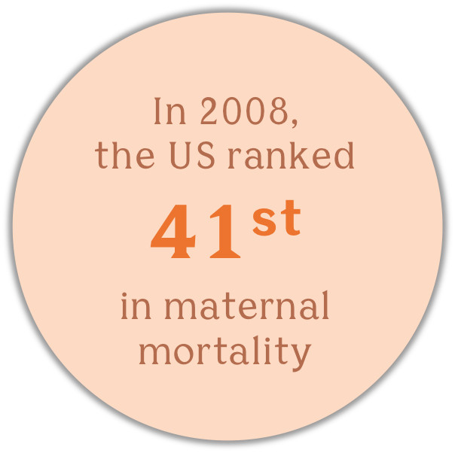
CONTEXT
The maternal health crisis in the US
Where’s the M in MCH?
Not recognized as a problem
No accountability in the system
Over 10 years → greater attention
Maternal mortality review
Safety Bundles - protocols + guidelines
Notes:
I’d like to explain the context for our current priorities.
We know that the US spends the most of any country on maternity care, yet we have worse outcomes than all other wealthy countries.
In fact, we are the only developed country where the maternal mortality ratio is on the rise. And of course, we’ve heard about the intractable racial disparities.
But for many years maternal health hasn’t received the attention it deserves….
Where’s the M in MCH?
Not recognized as a problem
No accountability in US system
Over 10 years SIGNIFICANT effort has led to greater recognition and attention
There’s been considerable effort improve maternal health, focused on making sure that when something went wrong, (a complication developed) it could be appropriately addressed.
In the US, this has translated to establishing and strengthening maternal mortality review boards to identify and address failures in health systems. Visionary clinicians have leveraged their expertise and their position in the health system to make sure more providers and facilities are adopting ”safety bundles” -- protocols that can make the difference between life and death once an emergency or a complication has arisen.

Slide 3
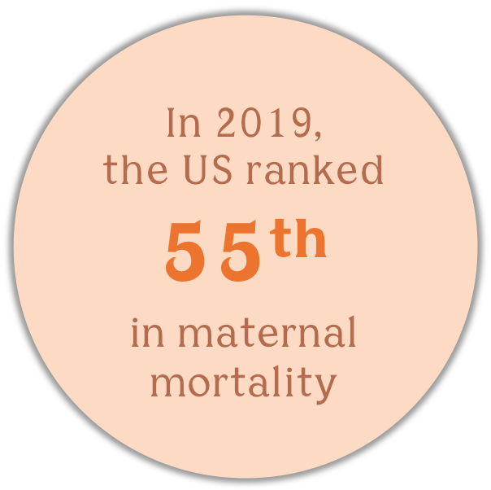
10 YEARS LATER…
Maternal mortality and severe complications continue to rise in US.
NOT High Value Care
Spend the most but…
Underuse high-value, low-tech strategies
Overuse interventions
High rates not linked to improved outcomes
Mistreatment, disrespectful care
Disparities remain unchanged
Notes:
BUT despite expanding implementation of protocols and guidelines and maternal mortality review, we HAVEN’T Seen as much change in outcomes as would be expected.
For instance California is the ONLY state in the US to significantly reduce it’s maternal mortality, and even there, racial disparities have not been reduced.
The same is true in New York City, where maternal mortality disparities have grown, even as numbers have inched downwards.
The strategies we’ve been employing have absolutely been contributing to improvements, but they aren’t going the distance.
So if the focus on emergencies, on “rescue” isn’t enough, what needs to happen to move the needle?

Slide 4
WHERE WE NEED TO GO
Quality, respectful, and equitable maternity care for all
`
MOVING FORWARD
HIGH QUALITY CARE
Rescue → Prevention
Clinical → Comprehensive
Top-down → Respect, dignity, rights
Disparities → Equity
We don’t
need to reinvent
the wheel!
Notes:
Research suggests the need to take a different approach,
to shift the focus upstream to prevent problems before they arise, moving from rescue to prevention taking a comprehensive approach to health and wellness.
Engaging people in their own care, so they can be active participants.
We need to focus on the quality of care in an expansive sense – not just as an emergency solution but providing ALL people with the best care from the beginning, throughout their life course.
- and adopt a richer definition of quality – one that recognizes the paramount importance of treating everyone with respect and dignity, as a person with rights and a voice – and one that rests on a bedrock of prioritizing equity.

Slide 5
HIGH VALUE MODELS OF CARE
Improving outcomes, enhancing the experience of care, reducing costs
`
Midwifery Model & Community-based Doulas
Evidence-based models to support optimal maternity care practices.
RESEARCH SHOWS BOTH MODELS:
Result in safer, healthier, more satisfying births
Facilitate self-advocacy & satisfaction
Increase health equity
Reduce spending
…yet both models are underutilized.
Notes:
How do we move in this direction?
MIDWIFERY MODEL of CARE + COMMUNITY-BASED DOULAS are both
Evidence-based models to support optimal maternity care practices.
RESEARCH SHOWS BOTH:
Result in safer, healthier, more satisfying births
Facilitate self-advocacy & satisfaction with care
Increase health equity
Reduce spending

Slide 6
Where do we want to go?
More women are informed and equipped to exercise their agency
Increased availability and visibility of high-value models
Increase in respectful and positive maternity care experiences
Greater trust and utilization of the medical system and health services
Improved health outcomes for women and infants
High-value care - cost-effective spending with better outcomes/experiences … better ROI
Notes:
Transforming the current care model, which continues to fail women, to one that is rights-based, person-centered, culturally-relevant, and rooted in dignity and respect will lead to (bullets on slide)
Ultimately, a new maternity care paradigm can serve as a model to be replicated and scaled across all areas of the U.S. healthcare system.

Slide 7
Highlights from 2019
Bipartisan commitment to maternal health + Medicaid extension
Energy & Commerce bills
Helping MOMS Act
Medicaid Extension + Doula Report (from MOMMIES Act)
Maternal Health Quality Improvement Act of 2019
Rural health + Demonstration Projects
Black Maternal Health Caucus leadership – 9 more bills
Notes:
Highlights from 2019
Helping MOMS Act: Bipartisan Leadership
Allows states to extend Medicaid coverage for postpartum women from 60 days to one year after birth
Includes a plan to evaluate and support states adopting Medicaid coverage of doula services
Less than two weeks ago, it passed out of the Energy and Commerce Committee and has the potential to be voted on by the House of Representatives.
Maternal Health Quality Improvement Act of 2019: Bipartisan Leadership
Seeks to address significant disparities in access to maternity care that women in rural areas experience, through a number of initiatives including a new rural Maternal and Obstetric Care Training Demonstration project to support the training of rural providers (additionally supports improvements in data collection and the expansion of existing Federal Telehealth Grant Programs to include birth and postpartum service)
Establishes quality of care provisions, such as implicit bias training for health care providers and Perinatal Quality Collaboratives.

Slide 8
Federal Legislation
Maternal Health Awareness Day
Native Women’s Maternal Health Resolution
BABIES Act
Midwives for MOMS Act
MOMMIES Act
MOMMAS Act + many, many more!
Key topics → perinatal support, midwifery model, and equity
Notes:
Maternal Health Awareness Day Resolution
This week, Senator Booker introduced a Resolution establishing 1/23 as Maternal Health Awareness Day
The Resolution brings attention to the disproportionately poor maternal health outcomes of Indigenous women + calls for prioritizing policy changes to address disparities by increasing funding for and access to comprehensive and culturally-appropriate maternal and reproductive health services for Indigenous communities.
Native Women’s Maternal Health Resolution
Last week, Congresswoman Deb Haaland, Native American NM, introduced the Native Women’s Maternal Health Resolution
Resolution brings attention to the disproportionately poor maternal health outcomes of Indigenous women + calls for prioritizing policy changes to address disparities by increasing funding for and access to comprehensive and culturally-appropriate maternal and reproductive health services for Indigenous communities.
Babies Act
Establishes the first ever quality standards specific to maternity and newborn care under Medicaid and the Children’s Health Insurance Program.
Midwives for MOMS Act
Establishes two new streams of funding for midwifery education, focusing on students from racial and ethnic minority groups or disadvantaged communities.

Slide 9
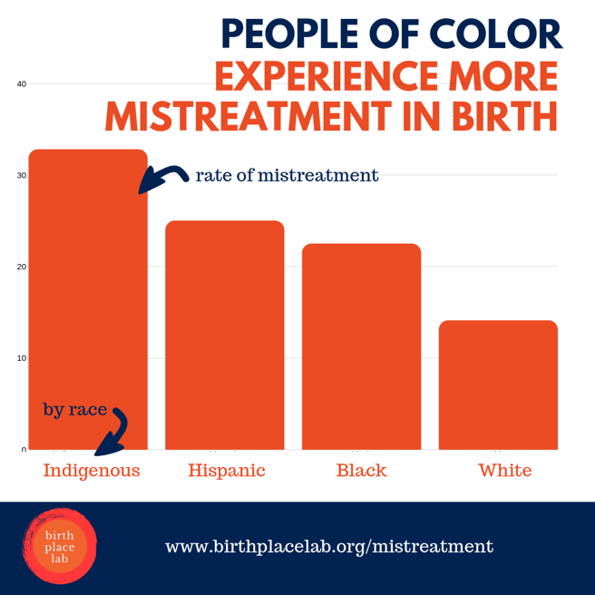
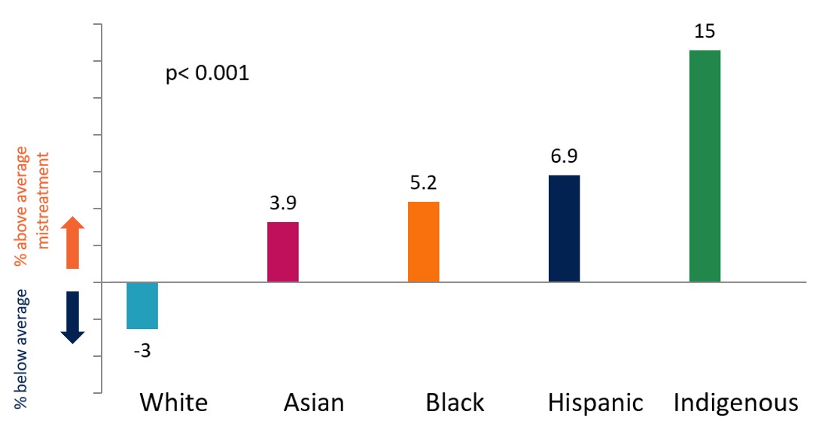
Mistreatment Findings
Rate of mistreatment by race
Notes:
WHAT DID WE FIND
One in six women (17.3%) and 1 in 4 women with a hospital birth experienced one or more types of mistreatment
Being shouted at or scolded by a health care provider was the most commonly reported mistreatment (8.5%)
followed by health care providers ignoring women, refusing their request for help, or failure to respond to requests for help in a reasonable amount of time (7.8%).
Less common types were: violation of physical privacy (5.5%) and providers threatening to withhold treatment or forcing women to accept treatment they did not want (4.5%).
People of color, Indigenous, Hispanic, and Black people are more than 2x as likely to experience mistreatment than white women

Slide 10
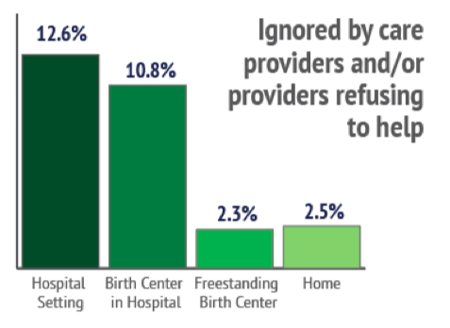
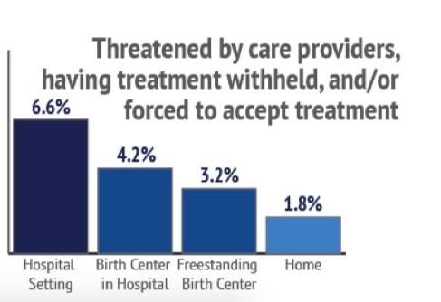
Notes:
Community birth settings were protective of mistreatment

Slide 11
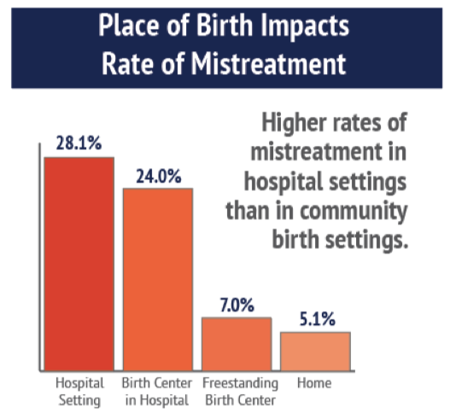
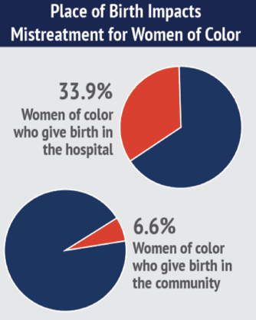
Mistreatment by Place of Birth
Notes:
However, these numbers understate the problem, because remember that 50% of the sample were community births, compared with 2% of the population overall.
Why? Because place of birth strongly affects the rate of mistreatment.
Giving birth in a Hopsital setting or even a birth center within a hospital results in a much greater likelihood of mistreatment than giving birth in a freestanding birth center or at home.
So in reality the rates of mistreatment are much higher in the population than in our sample– in hospital births it’s 1 in 3 women of color experienced mistreatment compared with just 6.6% in the community. (1 in 15)
For white women giving birth in a hospital, 1 in 4 report experiencing mistreatment.

Slide 12
Measuring Mistreatment by Place of Birth + Provider Type
Women who reported 1+ mistreatment item:
Midwife + community birth: 4.8%
Midwife + hospital birth: 23.8%
Doctor + hospital birth: 30%
Notes:
When comparing data by provider type, not only place of birth.
You see a difference in physicians and midwives in hospital settings, but a much greater difference between hospital birth and community birth.

Slide 13
Implications – Consequences of Mistreatment
Prevalence of reports of mistreatment in a high resource setting
“being ignored”
“providers failed to respond to their requests for help”
Additional research needed
The California Pregnancy-Associated Mortality Review (CA-PAMR):
Healthcare provider factors - most common contributor to maternal deaths,
81% of maternal deaths in that time period.
The most common provider factor was delayed response to clinical warning signs, followed by ineffective care
Notes:
The significant number of respondents that reported “being ignored” or that “providers failed to respond to their requests for help” is a disturbing finding especially in a high resource country.
These results are directly related to mortality and morbidity.
The California Pregnancy-Associated Mortality Review (CA-PAMR): found that
Healthcare provider factors - most common contributor to maternal deaths,
Factors in 81% of maternal deaths in the time period studied.
The most common provider factor was delayed response to clinical warning signs, followed by ineffective care

