Slide 1
What’s Next? Coverage and Affordability Opportunities in Red, Blue, and Purple States
Heather Howard
January 24, 2020
A grantee of the Robert Wood Johnson Foundation

Slide 2
Agenda
Key Themes
States Leaning In/Leaning Out
Section 1332 Waivers
Public Option/Buy-in Models
Marketplace Transitions
Other Affordability Proposals

Slide 3
Dynamic Federal Policy Environment
ACA litigation creates uncertainty
Public charge rule has chilling effect on enrollment in health programs
Is Federal government a reliable partner?

Slide 4
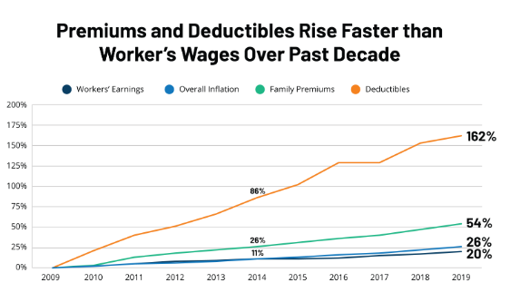
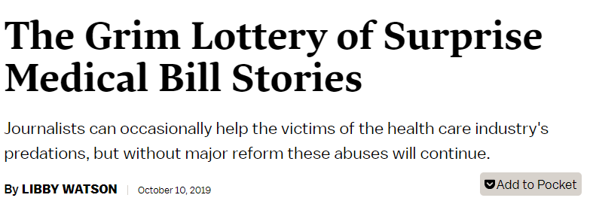
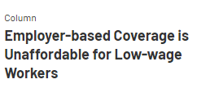
Plan Affordability Remains a Problem
4
Notes:
Most states experienced double digit rate increases in 2017 and 2018, partly due to silver loading. Rate increases continue to vary dramatically by state and region, but most states will see single digit rate increases (or even decreases) for 2020.

Slide 5
Key Themes for States
Expanding health insurance coverage to residents
Addressing health care affordability
Preserving the Affordable Care Act

Slide 6
States Lean In
Create state reinsurance programs via Section 1332 waivers
Develop/explore public option/buy-in programs
Transition marketplace functions from federal platform to a state-based platform

Slide 7
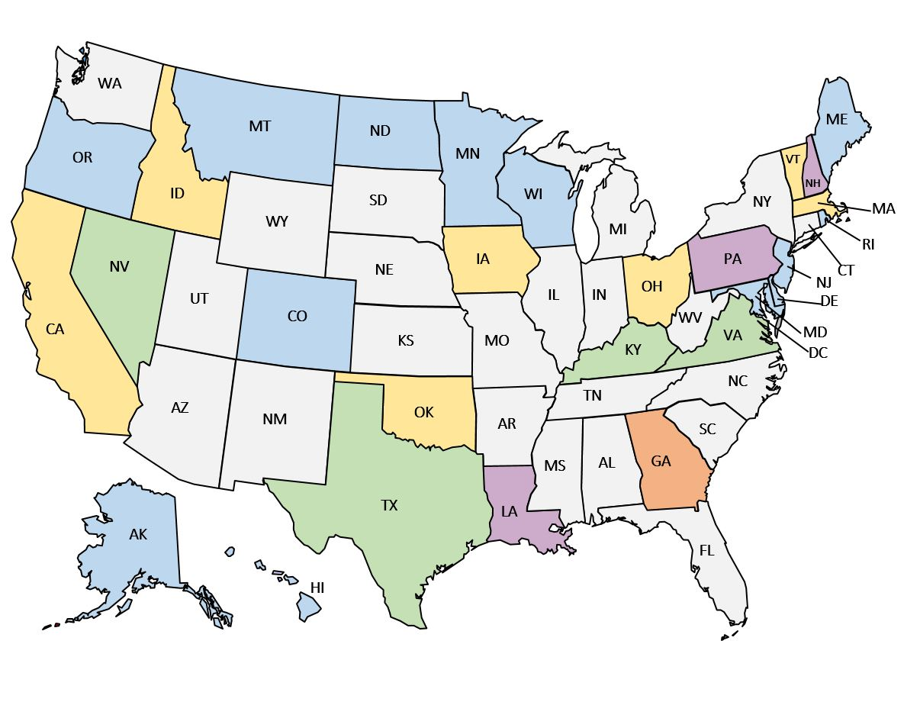
Status of 1332 Activity
Waiver approved (12)
Waiver application submitted
Public draft of application
Waiver application withdrawn/
deemed incomplete
Authorizing legislation enacted

Slide 8
Types of 1332 Waivers [Approved]
Reinsurance program (AK, CO, DE, ME, MD, MN, MT, NJ, ND, OR, & WI )
Stabilizes individual market through state-funded reinsurance program for high cost claims
1332 waiver allows state to recoup (“pass-through”) some of the savings that accrue to the federal government due to lower premiums
Other ideas?

Slide 9
Medicaid Buy-In or Public Option
Definition: evolving, but generally state provides coverage that may be more affordable and/or accessible than current options in individual and employer markets by leveraging government buying power
Goals: increase affordability, access, competition, single payer glide path (or obstacle)?
Considerations: provider networks, reimbursement rates, impact on existing insurance markets, insurer reactions, need for federal waiver?

Slide 10
Medicaid Buy-In and Public Option Proposals 2019
Enacted the nation’s first public option bill in May 2019
Introduced bills allow individuals with higher incomes to buy-in to the state BHP program; the bills did not pass in the 2019 session
Proposed legislation to authorize a work group to establish a state public option for 2021; the bill did not pass in the 2019 session
Washington
Enacted a law with provisions to study a state Medicaid buy-in or public option
Minnesota
Oregon
Connecticut
Nevada
New Jersey
Colorado
Appropriated funds in the FY2020 budget to study a BHP and “Medicaid-like” option
Enacted a bill for a “state option for health care coverage” in April 2019. State regulators sent a final report to legislature in November 2019.
Passed a bill in June 2019 to study a SEHP-based public healthcare insurance plan
New Mexico
Enacted appropriations for an additional Medicaid buy-in study in March 2019
States that considered buy-in/public option legislation
States that considered study legislation
States that considered both buy-in/public option and study legislation
States with previous studies or commissions tasked with studies

Slide 11
Marketplace Transitions
State-based marketplaces (SBMs) continue to outperform the federally-facilitated marketplaces
Benefits of transitioning include greater autonomy over key marketplace functions such as:
Plan management;
Outreach and marketing; and
IT and operations.
States can receive detailed enrollment data on consumers and better tailor plans to meet consumer needs

Slide 12
State-Based Marketplaces
WA
MT
ND
ME
OR
MN
VT
ID
SD
WI
NY
NH
WY
MI
MA
IA
PA
RI
NV
NE
CT
UT
IL
IN
OH
NJ
CO
WV
DE
CA
KS
MO
KY
VA
MD
NC
DC
AZ
OK
TN
NM
AR
SC
MS
AL
GA
TX
LA
AK
FL
HI
State-Based Marketplaces
Transitioned to a SBM Beginning Plan Year 2020
In Process of Transitioning for Plan Year 2021
SBM Operating on Federal Platform
Considering Transitioning After Plan Year 2021

Slide 13
Other Affordability Policy Decisions
Develop individual mandate
California, D.C, New Jersey, Rhode Island, and Vermont follow Massachusetts
Standardize health plan benefit designs
California, Connecticut, D.C., Massachusetts, New York, Oregon, Vermont, and Washington
Maintain ACA protections
Expand ACA subsidies
California will offer subsidies to those above ACA subsidy cut off (400-600% FPL) with state funding
Set health care spending targets
Delaware, Oregon and Rhode Island follow Massachusetts
Address surprise billing
28 states total, including Missouri, Nevada and Washington [latest states to enact legislation]
Enroll the eligible but uninsured
All states concerned with coverage and affordability

Slide 14
State Individual Mandates
WA
MT
ND
ME
OR
MN
VT
ID
SD
WI
NY
NH
WY
MA
MI
RI
NV
NE
IA
PA
CT
UT
IL
IN
OH
NJ
CO
WV
DE
CA
KS
MO
VA
MD
KY
TN
NC
DC
AZ
NM
OK
AR
SC
MS
AL
GA
TX
LA
AK
FL
HI

Slide 15
Thank You
Heather Howard
Director
State Health and Value Strategies
heatherh@Princeton.edu
609-258-9709
www.shvs.org

