Slide 1
Outreach & Enrollment Funding + Programming Landscape

Slide 2
Who We Are + How We Are Different
Nationally certified women & minority-owned (MWBE)
Mission driven, flexible rates
Customized solutions based on your problem
See what our clients have to say transformhc.com
Notes:
We are nationally certified as women and minority owned health care consulting firm.
Our staff works with leaders in the public and private sectors to drive solutions that promote efficiency, value, and access to care, in order to address key social determinants of health to improve health outcomes.
We provide thought leadership, strategy and policy advice, professional mentorship and coaching, research and writing assistance, program implementation, staff augmentation and more. You can read about our staff via our website at transformhc.com and follow us on Twitter @transformhc
Stay tuned for the end of this session where we will have a short raffle of some giveaways! Please put your business card in for the raffle.
Goal of this session:
The critical need for outreach and enrollment remains constant in our changing health care landscape. Consumers will always need help no matter what the landscape looks like. As the numbers of uninsured continue to increase, it’s clear that navigation is key for reaching people with the right messages at the right time.
Read speaker bios and introduce panel.

Slide 3
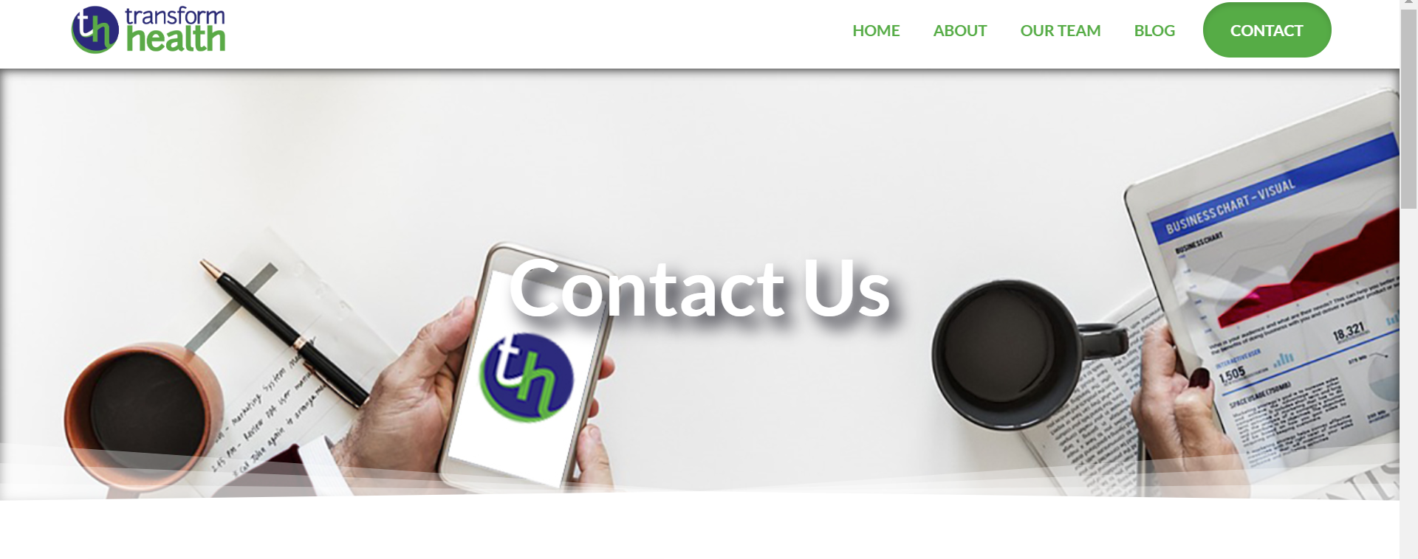
www.transformhc.com
Join our
Notes:
Sign up for our email list or just get in touch with us by going to our website! We want to help support your work by working with you.
https://www.transformhc.com/

Slide 4
Session Speakers
Sara Gleysteen, MPH Transform Health
Erin Hemlin, MA Young Invincibles
Moderator:
Heather Bates, MSW, Transform Health

Slide 5
Outreach in a Complex Climate
Headline Fatigue
Misinformation
Texas v.
United States
Public Charge
Cuts to Marketing and Advertisements
Work Requirements
Prioritizing Agents and Brokers
Shortened OEP
No Mandate
Short-Term, Catastrophic Plans
“Trumpcare” Ads
Negative Media
Consumer Confusion
Inaction: “Numb Out”
Fear
Notes:
Icebreaker: how was open enrollment?
No shortage of challenges
Yet, you are still the trusted messengers
People still need help
You are still the first line for many in your communities
In the current climate, there are a variety of challenges facing consumers. Short term plans, shortened OEP, fear
As I’ve mentioned Texas V. Azar, Public Charge, as well as cuts to marketing and advertisement coupled with no mandate have made it very difficult to sustain robust enrollment efforts in the marketplace and elsewhere. All that to say consumers are fundamentally confused, these changes are compounded by their coverage in the media as well headline fatigue.
Transition slide to talk about outreach

Slide 8
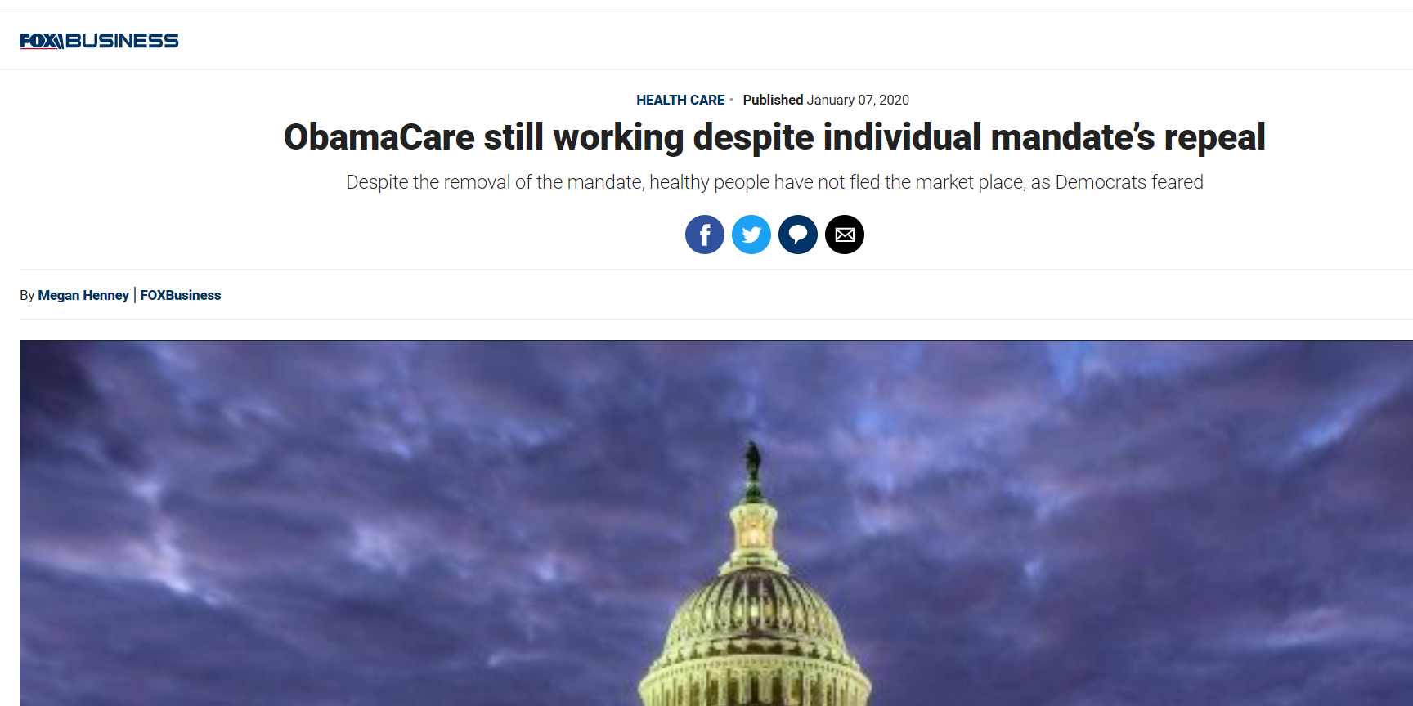
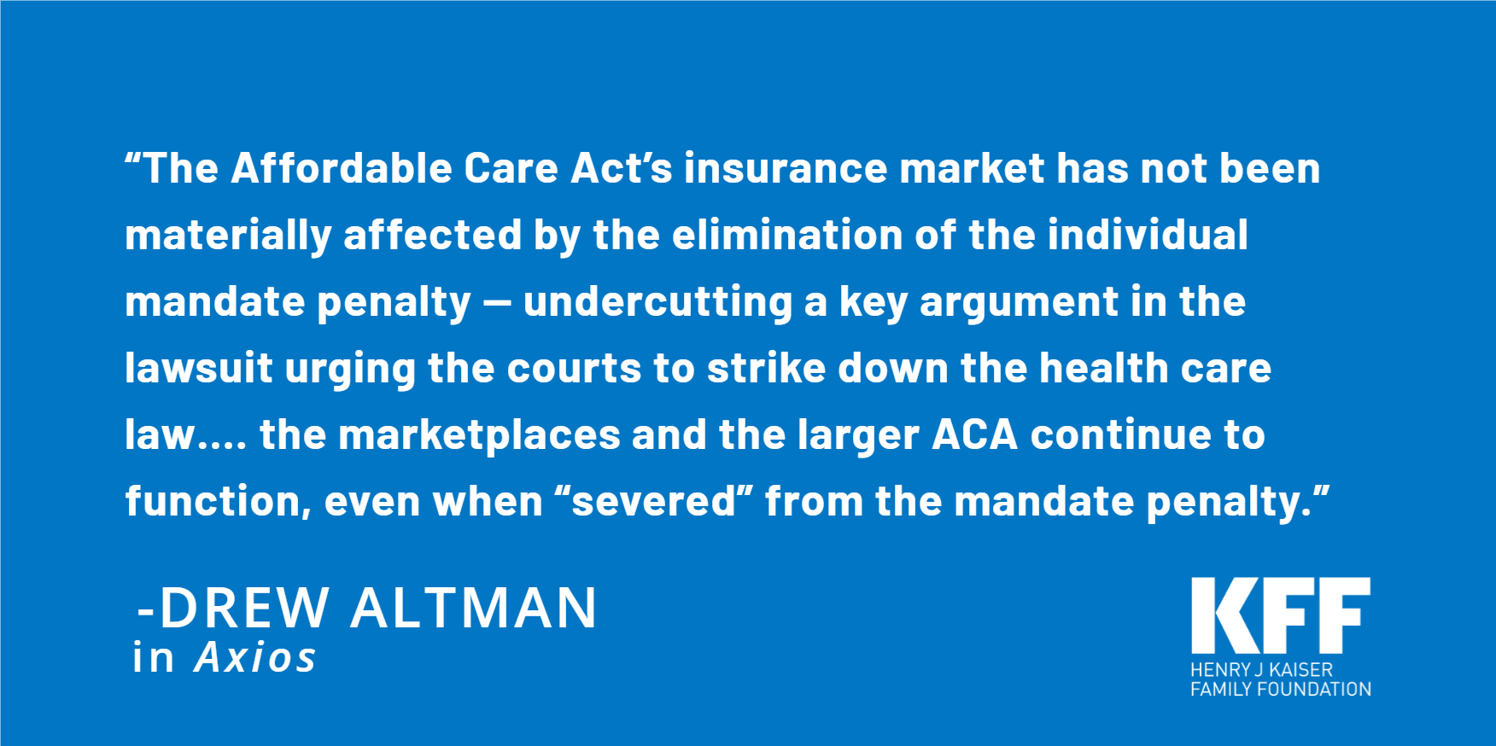

Slide 9
Outreach & Enrollment Updates
Erin Hemlin, Health Policy & Advocacy Director
Erin.Hemlin@younginvincibles.org
fb.com/together.invincible
@younginvincible

Slide 10
Agenda:
Resources & Updates:
Get Covered Coalition
Get Covered Connector
OE7 By The Numbers:
OE7 FFM Final Enrollment Data
Year to year comparisons
What had the biggest impact on overall enrollment?
Notes:
Intro to session/Transform/YI - 2 mins
Icebreaker - 15 mins? (Depending on how many people are there this could take forever, thoughts on how to do this quickly? Maybe we just skip?)
Erin presents: 20 mins
- Reminder about resources (Coalition/Connector) - 2 mins
- OE7 numbers/trends - 5 mins
- Quick overview: what do we think impacted these numbers the most this year? - 10 mins-ish
-- Dichotomy of the good: more choice, affordability and the bad: expanded short-term plans, limited funding support, confusion
Sara presents: 20 mins
- Texas v US update - 10 mins
- How to communicate the case, other federal policy updates to consumers from an assister lens - 10 mins
Open Q&A: - 25 mins
- Mina and Heather help facilitate
- Mina kicks off with prepared question(s) for panel/audience

Slide 11
Resources & Updates

Slide 12
About the Get Covered Coalition
Highlights:
500+ members in nearly every state
Provide materials, trainings, unbranded social media content, outreach toolkits, and relevant policy updates to enrollment community
Monthly meetings on every third Wednesday at 2pm ET
Opportunity to share best practices, lessons learned, troubleshooting with other seasoned assisters

Slide 13
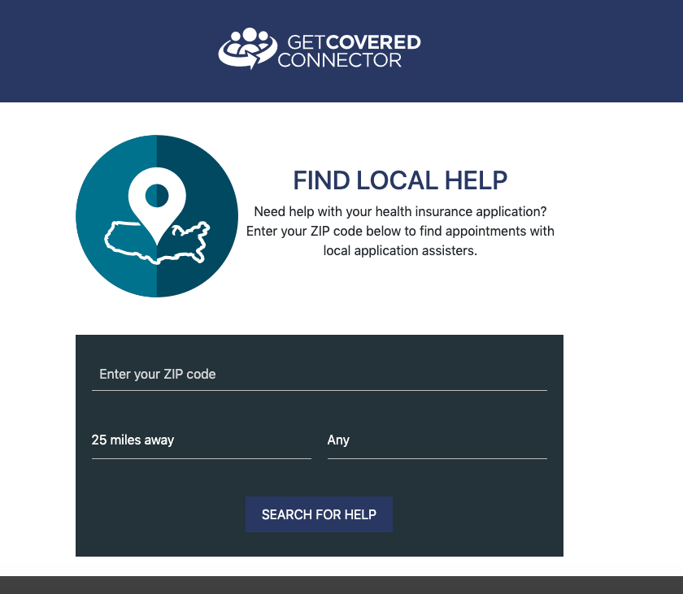
About the Get Covered Connector
What it is:
Online scheduling and appointment management tool tailored to marketplace enrollment assistance
Allows assisters to input appointments, record outcomes, and run data reports
Allows consumers to find assisters in their area and book appointments online, receiving text message and email reminders
Fully upgraded in 2018, we plan to continue to improve the tool to (hopefully) make your lives easier

Slide 14
The Numbers are in: OE7 in HealthCare.Gov States
 | OE6 | OE7 | % change
Renewals | 6.33 million | 6.24 million | -2.2%
New Enrollment | 2.0 million | 2.06 million | +0.7%
Total Enrollment | 8.34 million* | 8.30 million | -0.5%
Highlights:
Overall steadiness shows the resiliency in the ACA despite lack of awareness, funding, expansion of short-term plans, and technical glitches with HealthCare.Gov
New enrollment actually increased despite all of this, likely due to the prevalence of zero dollar and low cost plans -- also means that enrollment overall should have increased

Slide 15
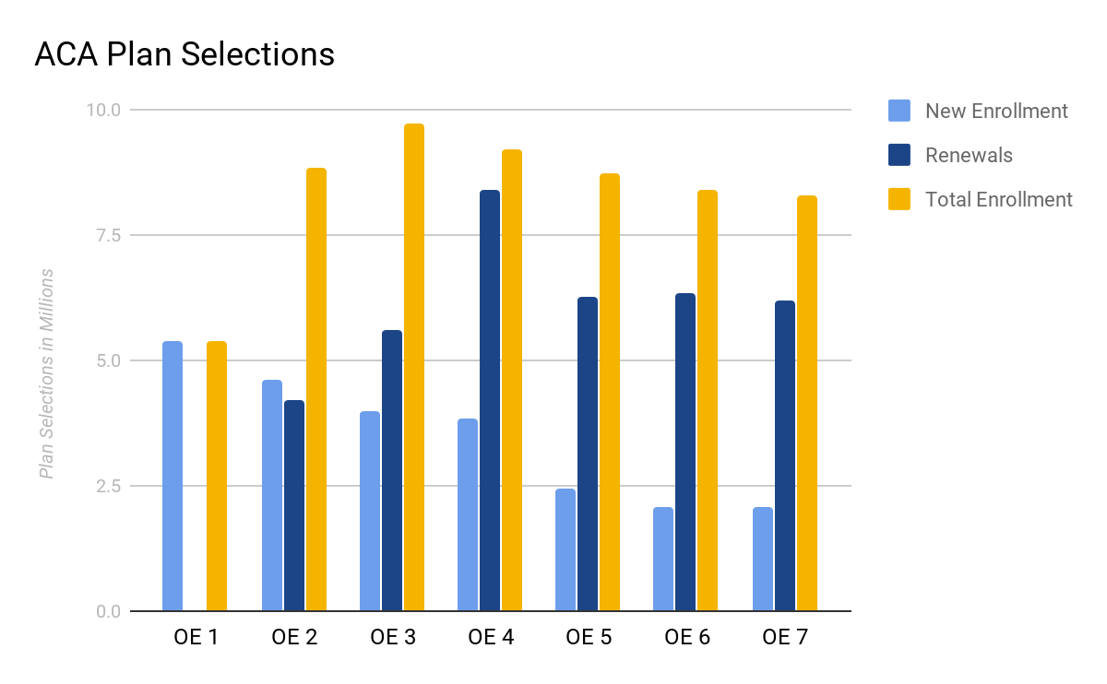
ACA Enrollment Over Time
Notes:
https://www.cms.gov/newsroom/fact-sheets/health-insurance-marketplaces-2017-open-enrollment-period-final-enrollment-report-november-1-2016
All data: https://www.cms.gov/Research-Statistics-Data-and-Systems/Statistics-Trends-and-Reports/Marketplace-Products/2019_Open_Enrollment

Slide 16
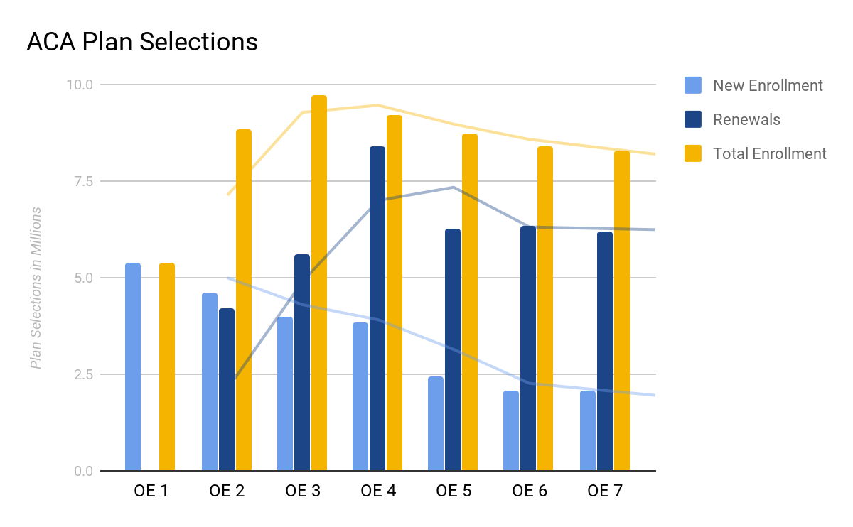
ACA Enrollment Over Time
Notes:
https://www.cms.gov/newsroom/fact-sheets/health-insurance-marketplaces-2017-open-enrollment-period-final-enrollment-report-november-1-2016
All data: https://www.cms.gov/Research-Statistics-Data-and-Systems/Statistics-Trends-and-Reports/Marketplace-Products/2019_Open_Enrollment

Slide 17
What Influenced Open Enrollment This Year?
Defunding & Deregulation
90% cut in outreach & advertising
84% cut in Navigator funding
Short-term plans flooded the market
Administrative Action & Court Challenges
Health Care Repeal Lawsuit
Public Charge Rule Chilling Effect
Competition
More insurers participated in the market, creating more plans for consumers to choose from
Affordability
9 in 10 shoppers qualified for financial help; of those 2 in 3 could find a plan for $10/mo or less
4.7 million shoppers could find a $0 plan

Slide 18
Key Takeaways:
8.3 million enrolled is impressive given extreme challenges
New enrollment increasing is an early but positive sign
Enrollment numbers should be even stronger if weren’t for sabotage efforts, and technical glitches
Much of this success is thanks to the steady & strong enrollment community

Slide 19
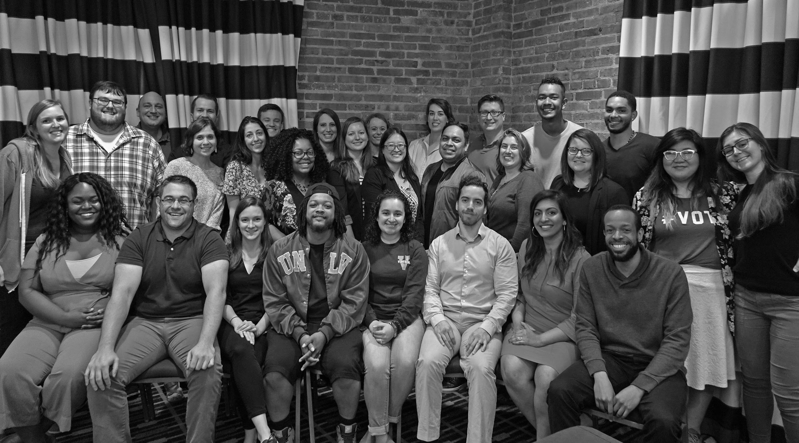
Thank You!
YoungInvincibles.Org
Erin Hemlin: Erin.Hemlin@younginvincibles.org
fb.com/together.invincible
@younginvincible

Slide 20
Get In Touch With Us
Follow us
@transformHC
Contact us
lisa@transformhc.com
heather@transformhc.com
Find us
www.transformhc.com

