Slide 1
Colorado: Addressing Affordability through Rate Review
Debra Judy
Jan. 23, 2014

Slide 2
Colorado Rate review
Colorado FAIR Act passed in 2008
Requires prior approval of health premium rate increases
Standard for Rate Review
Excessive
Inadequate
Unfairly Discriminatory
3 Federal Rate Review Grants
Add actuarial staff
Develop more consumer friendly website
Conduct consumer outreach
Enhance health pricing transparency

Slide 4
Consumer Savings

Slide 5
Colorado Rate Review Timeline

Slide 6
CCHI’s Role in Rate Review
Filed comments on rate increases with the Division of Insurance
Issues highlighted:
Combined impacts of multiple year rate increases
Lack of justification for trend projections
Profit in relation to proposed increase
Access to “confidential” information

Slide 7
Successes
Golden Rule Proposed 24% Rate increase (Aug. 2013)
Denied. Tried to make almost all rating information confidential.
CIGNA Proposed 24% Rate Increase Denied (Aug. 2012)
Denied. Raised some consumers premiums by as much as 75%. Also attempted to create a separate rating area for mountain regions in Colorado, with a 34% average increase.

Slide 8
Challenges & Opportunities
Learning Curve
Length of filings
Need for actuarial support
Timing
Colorado rates now filed at the same time
30 day comment period
Behind the scenes negotiations

Slide 9
Partnering with DOI
Provide website feedback
Helped develop consumer friendly disposition letters and language explaining DOI decisions
Sharing educational and presentation materials
Weekly updates on open policy filings

Slide 10
Engaging Consumers
Media Outreach
Messaging
Reduce waste
Increase transparency
More accountability
Public education efforts

Slide 11
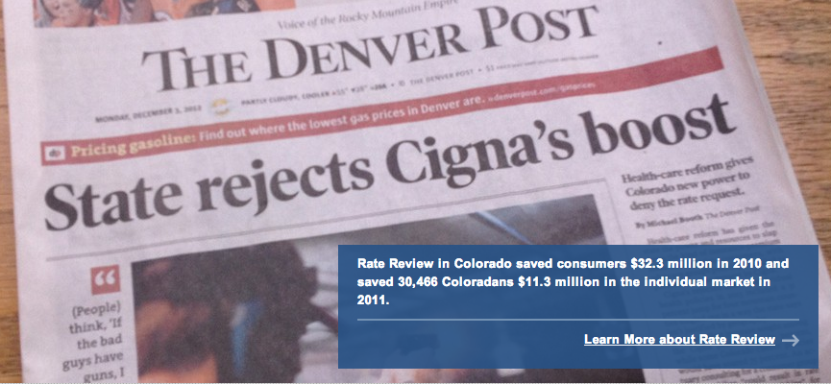
Media Outreach

Slide 12
SOCIAL MEDIA: Rate Review is Sexy
Think #RateReview is boring? It saved CO consumers more than $11 million last year. Now that’s sexy! #cohealth
Fed up w/huge health insurance rate hikes? Tell DOI @DORAColorado #RateReview
Coloradans like you are speaking up about unreasonable health insurance rate hikes; we can use #RateReview to stop that practice.
Health insurers should do all they can to negotiate low rates & improve plan quality for CO consumers. #RateReview
Let’s use #RateReview to hold insurers accountable for cutting waste and prioritizing prevention.

Slide 13
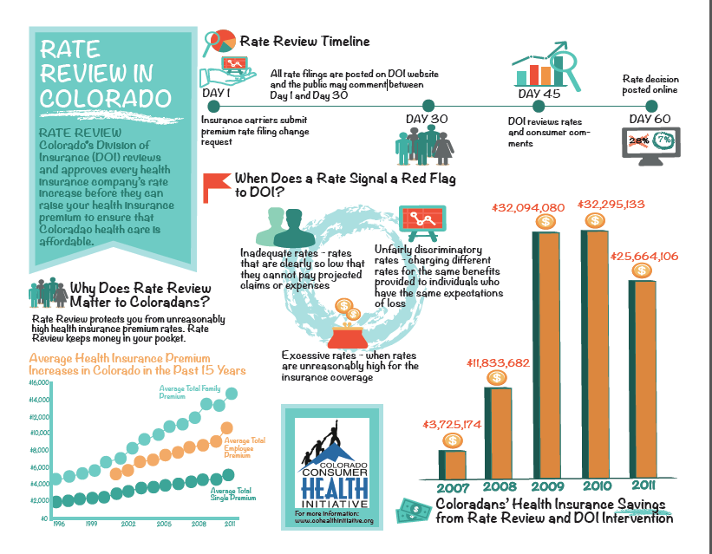

Slide 14
The Vision for the Future
Increased transparency for consumers
Public hearings
Consumer notification of proposed rate increases
Evaluate plans for cost containment and quality improvement as part of rate review

Slide 15
additional Resources
Consumer’s Union (2011). An Advocate’s Guide to Health Insurance Rate Hikes.http://consumersunion.org/wp-content/uploads/2013/02/Consumers_union-health_insurance_rate_review_toolkit.pdf
OSPIRG Foundation (2013). Advancing Accountability: Cutting Health Care Waste. http://ospirgfoundation.org/sites/pirg/files/reports/OSPIRG%20Foundation%20Advancing%20Accountability%20report.pdf
Questions?
Debra Judy
djudy@cohealthinitiative.org
303-839-1261

