Slide 1
Health Action 2015: Improving Cost-sharing and Premium Affordability in the Marketplace
Lydia Mitts, Senior Policy Analyst

Slide 2
What’s the problem?
Silver and bronze plans are most popular, but most have high upfront out-of-pocket costs
2015 Average Silver Plan Deductible: $2,658
Fewer plans cover services pre-deductible
Federal financial assistance still leaves some consumers exposed to high costs
Notes:
RWJF research has found that fewer marketplace silver plans are cover even services like a primary care visit prior to the deductible being paid, compared to employer-based coverage
Federal financial assistance through cost-sharing reductions helps mitigate against high deductibles. But this help only goes so far.

Slide 3
Strategies Beyond State and Federal Assistance?
State & Federal Policies to Improve Marketplace Plan Offerings
Cost-sharing Requirements
Active Purchasing
Standardized Plans
Private Financial Assistance Programs

Slide 4
1. Improving Marketplace Plan Offerings
 | Community Health Choice Silver Plan, Texas Marketplace | Gunderson Health Plan IA 8O Silver Plan $2500-20%, Iowa Marketplace
Deductible | $0 | $2,500
Primary Care/Mental Health Visit | $40 copay/visit | 20% coinsurance after deductible
Specialist Visit | $75 copay/visit | 20% coinsurance after deductible
Urgent Care | $75 copay/visit | 20% coinsurance after deductible
Emergency Room | $250 copay/visit | $150 copay after deductible
Outpatient Surgery | $175 copay/visit | 20% coinsurance after deductible
Inpatient Facility Fee | $400 copay/day | $200 copay/day after deductible
Generic Drugs | $25 | $10 copay after deductible

Slide 5
Actuarial Value Provides Plan Flexibility
What is Actuarial Value (AV)?
Aggregate measure of the portion of a population’s health care costs a plan pays
Guides QHP cost-sharing levels
Silver Plan: 70 % AV
Bronze Plan: 60% AV
Calculated using Federal AV Calculator
Significant carrier flexibility in distributing cost-sharing to meet AV of a metal level
Notes:
Only based on in-network cost-sharing and covered services. Does not factor in out-of-network care or care for non-covered services.

Slide 6
Improving Plan Offerings: Federal Advocacy
Federal Advocacy Priorities
Federally require plans at every metal level to cover key services pre-deductible
Primary care visits
Generic drugs
Secondary preventive services
Developing model plan designs to push HHS to offer on FFEs or through Multi-State Plans
Notes:
Only based on in-network cost-sharing and covered services. Does not factor in out-of-network care or care for non-covered services.

Slide 7
Improving Plan Offerings: State Policy Options
Notes:
Only based on in-network cost-sharing and covered services. Does not factor in out-of-network care or care for non-covered services.

Slide 8
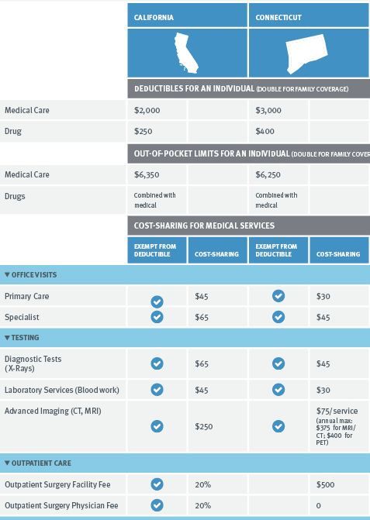
Closer Look: Standardized Plans
Insurers required to offer in state’s exchange
States with standardized plans: CA, CT, MA, NY, OR,VT (DC in 2016)
Many states designed silver plans with coverage pre-deductible
Snapshot: Silver Standard Plans in CA and CT, 2014
Notes:
Only based on in-network cost-sharing and covered services. Does not factor in out-of-network care or care for non-covered services.

Slide 9
DC’s Proposed 2016 Standardized Plans
Notes:
Bronze plan: $4,500 medical deductible + $200 drug deductible
Silver plan: $2,000 medical deductible + $250 drug deductible

Slide 10
DC Experience Designing Plans
Takeaways:
Find existing plan design as starting point
Consider ideal price point, existing market
Lower upfront cost-sharing possible, but be prepared to make trade-offs
Notes:
Only based on in-network cost-sharing and covered services. Does not factor in out-of-network care or care for non-covered services.

Slide 11
2. Private Financial Assistance
Local strategy to provide assistance with premiums + cost-sharing
Federal guidance supportive of nonprofit programs that:
Offer assistance the full plan year
Base eligibility on financial status
Notes:
Only based on in-network cost-sharing and covered services. Does not factor in out-of-network care or care for non-covered services.

Slide 12
2. Private Financial Assistance Cont.
Nonprofits partnering with local health systems for funding
Health Connect: United Way of Dane County, WI
Premium Assistance up to 150% poverty
Funding from U of Wisconsin Health System
Project Access Now, Portland OR
Premium Assistance up to 200% poverty
Nonprofit Hospitals/Community Providers waive remaining cost-sharing
Notes:
Only based on in-network cost-sharing and covered services. Does not factor in out-of-network care or care for non-covered services.

Slide 13
Additional Families USA Resources:
Designing Silver Plans with Affordable Out-of-Pocket Costs for Lower– and Moderate-Income Consumers: http://familiesusa.org/product/designing-silver-health-plans-affordable-out-pocket-costs-lower-and-moderate-income
Standardized Health Plans: Promoting Plans with Affordable Upfront Out-of-Pocket Costs: http://familiesusa.org/product/standardized-health-plans-promoting-plans-affordable-upfront-out-pocket-costs
Lydia Mitts
Senior Policy Analyst
Families USA
lmitts@familiesusa.org
(202)628-3030
1201 New York Avenue, NW, Suite 1100
Washington, DC 20005
main 202-628-3030 / fax 202-347-2417

