Slide 1

Listen to Us!
Joia Crear-Perry, MD, FACOG
January 25, 2019

Slide 2

Mission
To reduce Black maternal and infant mortality through research, family centered collaboration and advocacy.
VISION
That every Black infant and mother celebrate a healthy first year with their families

Slide 3
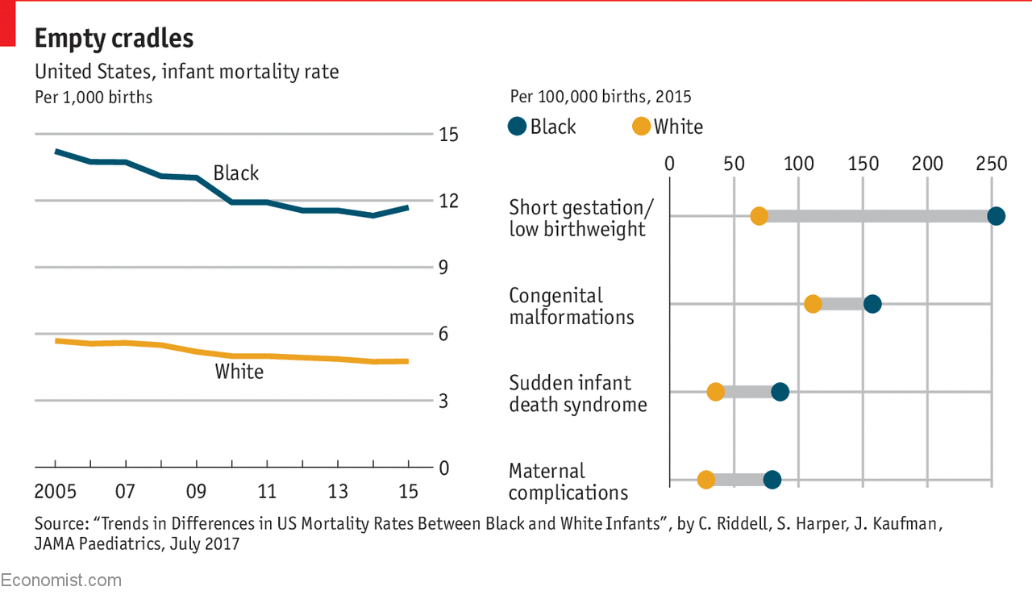
Infant & Maternal Health Inequities

Slide 4
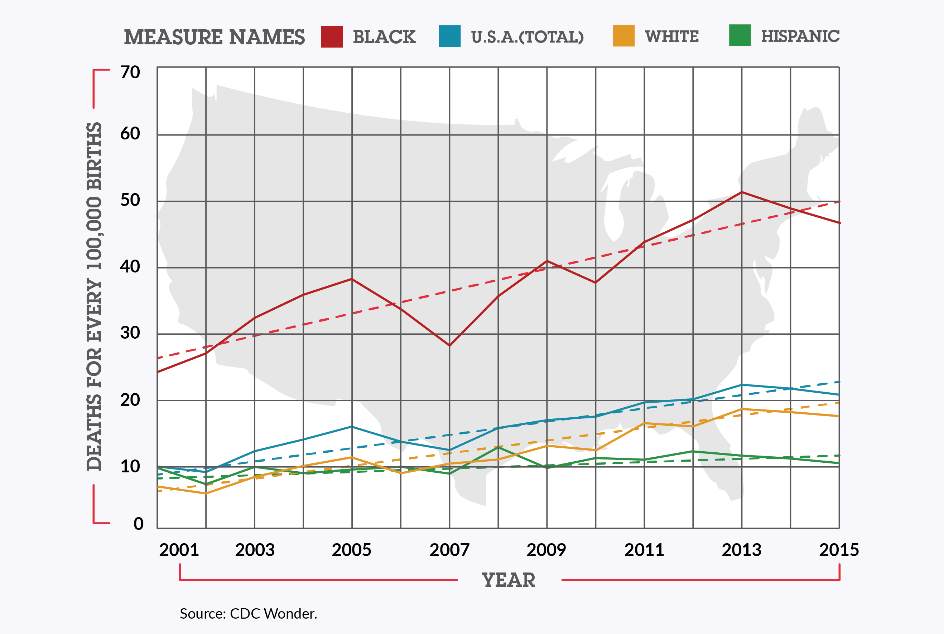
Outcome

Slide 5
Finding the Roots of Inequities
Black mothers who are college-educated fare worse than women of all other races who never finished high school.
Obese women of all races have better birth outcomes than black women who are of normal weight.
Black women in the wealthiest neighborhoods do worse than white, Hispanic and Asian mothers in the poorest ones.
African American women who initiated prenatal care in the first trimester still had higher rates of infant mortality than non-Hispanic white women with late or no prenatal. care.
Notes:
Ask people to keep these facts in mind as they view the video

Slide 6
Root Causes
Institutional
Racism
Class Oppression
Gender
Discrimination
and Exploitation
LABOR
MARKETS
TAX
POLICY
Power and Wealth Imbalance
GLOBALIZATION
&
DEREGULATION
HOUSING
POLICY
EDUCATION
SYSTEMS
SOCIAL
SAFETY
NET
SOCIAL
NETWORKS
Safe
Affordable
Housing
Job
Security
Social Determinants of Health
Transportation
Living
Wage
Quality
Education
Availability
of Food
Social
Connection
& Safety
Psychosocial Stress / Unhealthy Behaviors
Disparity in the Distribution of Disease, Illness, and Wellbeing
Adapted by MPHI from R. Hofrichter, Tackling Health Inequities Through Public Health Practice.

Slide 7
Racism as a Social Determinant and Root Cause
Racism affects health both directly (i.e., via chronic stress) and indirectly.
Race-based discrimination across multiple systems creates differential access to high-quality schools, safe neighborhoods, good jobs, and quality healthcare, in other words, by shaping SDOH.
Notes:
NBEC hopes to foster further dialogue on this issue, to help WIC adopt a common definition of racism, and to help staff to better understand how racism is related to the Social Determinants of Health and your work specifically.
Racism (not “race”) is a driver of health inequities, income inequities, and access inequities that drive people to your offices.
Racism affects health both directly (i.e., via chronic stress) and indirectly (i.e., via race-based discrimination across multiple systems which creates differential access to high-quality schools, safe neighborhoods, good jobs, and quality healthcare, in other words, by shaping Social Determinants of Health.)

Slide 8
NBEC Focus
Reproductive Justice
principles
Trainings & TA
Providing policy
improvements
Dismantling systems of power and racism
Assessing and educating on Birth Equity
Capacity building for community engagement
CLINICAL
+
SOCIAL

Slide 9
birth equity (noun):
1. The assurance of the conditions of optimal births for all people with a willingness to address racial and social inequalities in a sustained effort.
Joia Crear-Perry, MD
National Birth Equity Collaborative
Segregationists
Assimilationists
Anti-Racists
Notes:
“Slavery was as customary as prisons are today. Few could imagine an ordered world without them.”
― Ibram X. Kendi, Stamped from the Beginning: The Definitive History of Racist Ideas in America
“Of course, racist planters could not admit that Black runaways were self-reliant enough to effect their own safety and happiness—to be free.”
― Ibram X. Kendi, Stamped from the Beginning: The Definitive History of Racist Ideas in America
“When you truly believe that the racial groups are equal, then you also believe that racial disparities must be the result of racial discrimination. Committed to this antiracist idea of group equality, I was able to self-critique, discover, and shed the racist ideas I had consumed over my lifetime when I uncovered and exposed the racist ideas that others have produced over the lifetime of America.
“Racially discriminatory policies have usually sprung from economic, political, and cultural self-interests, self-interests that are constantly changing. Politicians seeking higher office have primarily created and defended discriminatory policies out of political self-interest—not racist ideas. Capitalists seeking to increase profit margins have primarily created and defended discriminatory policies out of economic self-interest—not racist ideas. Cultural professionals, including theologians, artists, scholars, and journalists, were seeking to advance their careers or cultures and have primarily created and defended discriminatory policies out of professional self-interest—not racist ideas.”
― Ibram X. Kendi, Stamped from the Beginning: The Definitive History of Racist Ideas in America
“That is what it truly means to think as an antiracist: to think there is nothing wrong with Black people, to think that racial groups are equal. There are lazy and unwise and harmful individuals of African ancestry. There are lazy and unwise and harmful individuals of European ancestry. There are industrious and wise and harmless individuals of European ancestry. There are industrious and wise and harmless individuals of African ancestry. But no racial group has ever had a monopoly on any type of human trait or gene—not now, not ever.”
― Ibram X. Kendi, Stamped from the Beginning: The Definitive History of Racist Ideas in America

Slide 10
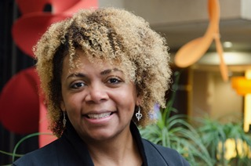


Thank you
Visit us at birthequity.org
Joia Crear-Perry, MD
Founder President
drjoia@birthequity.org
@birthequity

