Slide 1
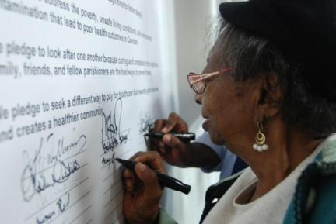
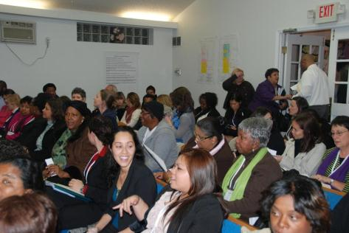
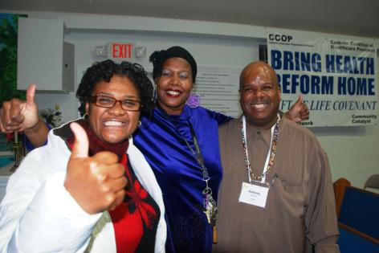

Slide 2
High School Graduation Rates
Newark: 67.7%
New Brunswick: 60.7%
Camden: 53.4%
Trenton: 48.6%
 | % of Persons Living below Poverty Level | # of People Living below Poverty Level
CAMDEN | 38.6% | 29,684
NEW BRUNSWICK | 31.4% | 17,530
NEWARK | 28.0% | 77,959
TRENTON | 26.6% | 22,436

Slide 3
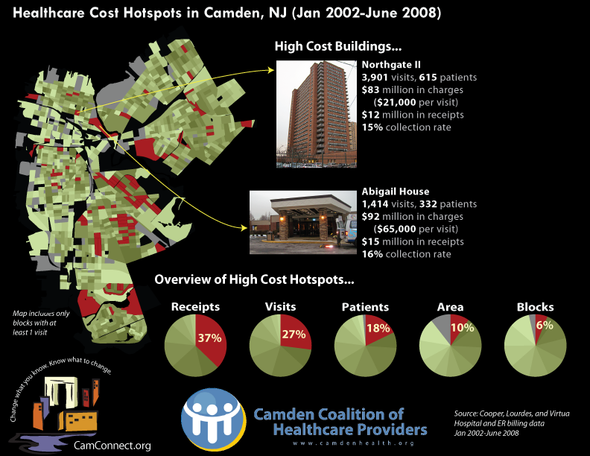

Slide 4
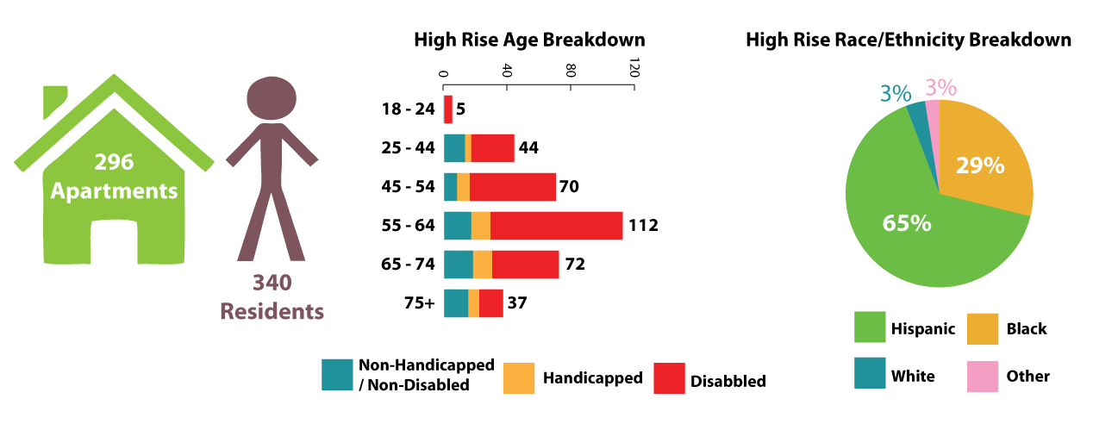
Who are NGII Hi-Rise Residents?
Non-Physically
or mentally
challenged
# = 71
Physically
Challenged
# = 43
Mentally
Challenged
# = 226
www.camdenhealth.org

Slide 5
Levels of High Utilizers

