Slide 1
The Creation of a Basic Health Program in Minnesota

Slide 2
TakeAction Minnesota
Statewide people’s network that works to achieve social, racial and economic justice in Minnesota
Primary spheres of influence: Health care, criminal justice, fair taxes and a more equitable labor market
Integrated campaigns – grassroots organizing, online, message and narrative, electoral work, coalitions

Slide 3
What is the Basic Health Program?
Allows states to create public health care coverage program for 138 – 200% FPL as alternative to the Exchange
MN is now the only state with the BHP (so far!)
Funded through 95% of tax credits for 138-200% FPL

Slide 4
Advantages of the BHP
Potential for much more affordable coverage for lower-income population
More people covered – legally present immigrants
Builds state public health care infrastructure
In MN – Improve and expand on MinnesotaCare

Slide 5
Coverage Spectrum with BHP
2
BHP Option*
Medicaid
Federal Tax Credits
No Tax Credits
0%
138%
200%
400%
*”Five-year-bar” legal residents are BHP eligible 0-200% FPL
Notes:
ACA –related changes are estimated to be a net plus to the state of $1.8 billion over five years.
Medicaid expansion
-early expansion – covered about 84,000 people (childless adults)
-second phase/full –additional 57,000 people
-savings (early to full) = $1.0 billion over five year period (FY2011 to 2015)
-100% match for first three years, gradually moving to a 90% match over time.
-individual mandate and impact on Medicaid is expected to cost state $146 million in 2015. Costs already accounted for in budget forecast.

Slide 6
The BHP Advantage
Plan type | Actuarial Value (AV)* | Cost-sharing (%)
Bronze | 60% AV | 40%
Silver | 87-94%* AV (after subsidies) | 6-13% (after subsidies)
MN BHP | 98-99% AV | 1-2%

Slide 7
How BHP Was Won in MN

Slide 8
BHP largely unknown in MN and elsewhere Exchange coverage “free” to taxpayers The MN legislature, Governor already overhwhelmed with ACA implementation + no HHS guidance
The Challenge

Slide 9
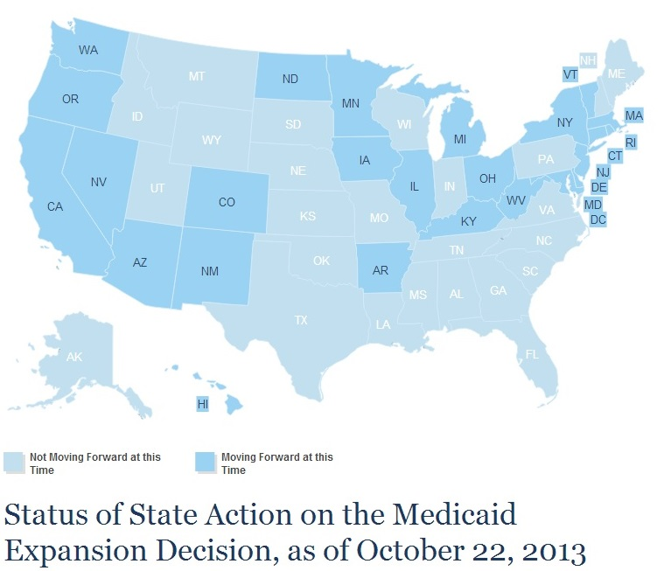
The Challenge

Slide 10
Three Winning Strategies
Strategy 1 – Recast the Choice
Strategy 2 – Build a Dream Team
Strategy 3 – Organize!

Slide 11
Strategy One: Recast the Choice
FROM:
Should MN Adopt a Basic Health Program
OR Have those MNs Get Tax Subsidies on the Exchange Instead?
TO:
Should MN Keep and Improve MinnesotaCare OR Eliminate It?

Slide 12
More on Language
“The Next Generation of MinnesotaCare”
Affordable health care vs the “Bronze Plan Trap”
No more “BHP”
High degree of message discipline

Slide 13
BHP Reframed
“The fate of MinnesotaCare - - the state-run health care program for low-income individuals and families … is in question. ….
What will happen to people enrolled in MinnesotaCare … The state has the option under the ACA of creating what's called a Basic Health Plan…”
Minnesota Public Radio, Daily Circuit, December 13, 2012

Slide 14
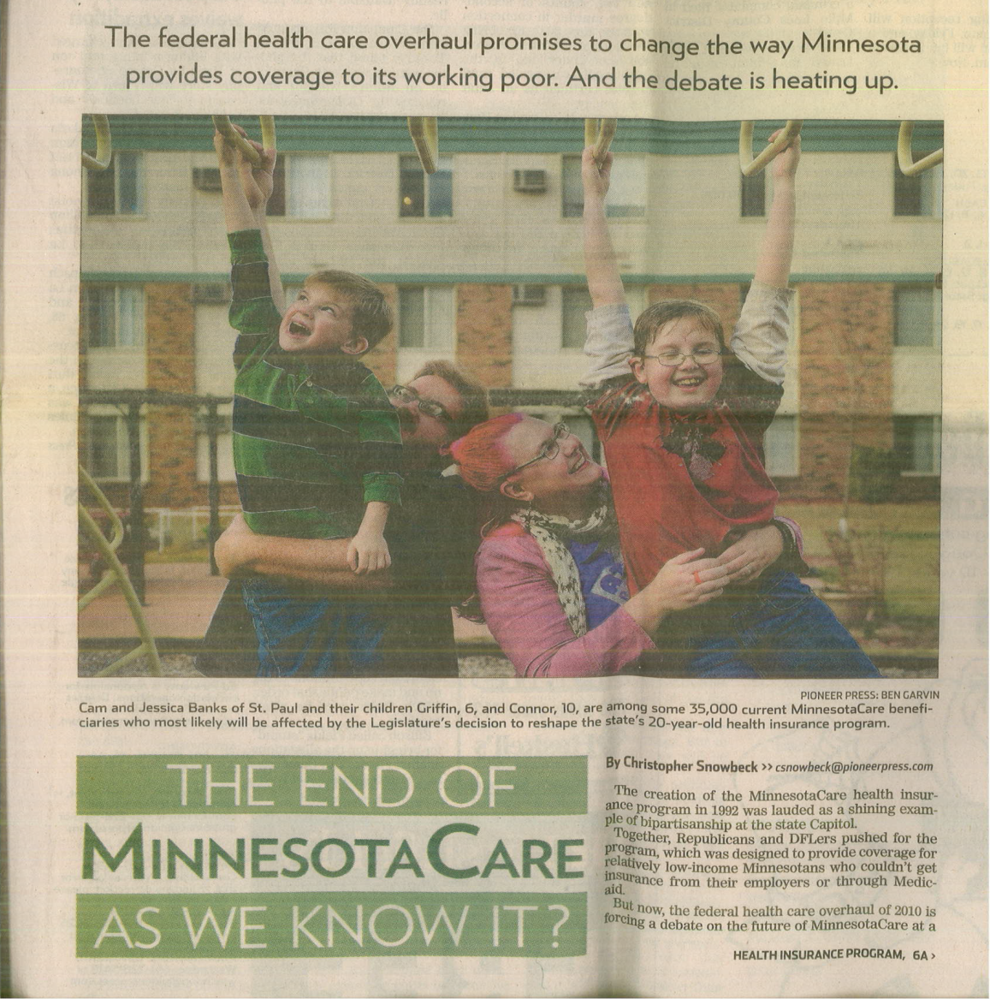
BHP Reframed
October 19, 2012, St. Paul Pioneer Press, Page A1

Slide 15
Strategy Two:
Build a Dream Team
Trusted Coalition
Grassroots leaders
Legislative and administrative champions
Strong Relationships
High Level of Coordination
Perseverance
Strong “Inside Team”
Friendly
Reporters

Slide 16
Strategy Three:
Organize!
Thousands of emails, dozens of memes, hundreds of phone calls + in-person lobbying meetings
Dozens of BHP eligible Minnesotans telling their personal stories
70 organizations signed on to support BHP

Slide 17
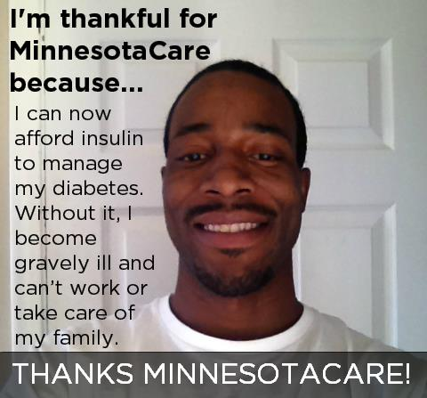
Strategy Three:
Organize

Slide 18
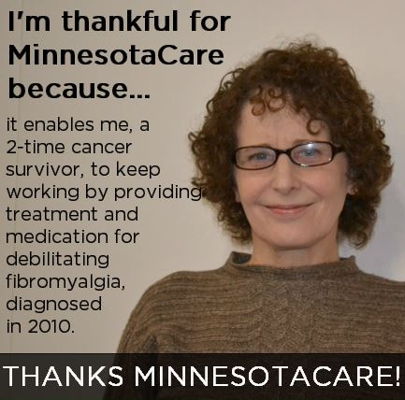
Strategy Three:
Organize

Slide 19
Strategy Three:
Organize

Slide 20
BHP is Passed in MN
MN Legislature: Passes BHP in 2013
Governor Dayton: Signs into law May 2013
Final legislation expands and improves MinnesotaCare
(1) Better benefit set – no hospital cap; AV = 99%
(2) No waiting periods, premiums reduced up to 50%
(3) 160,000 MNs projected to be covered
(4) Funded through Medicaid waiver through 2014

Slide 21
But Then, Of Course,
There’s Implementation
BHP in MN facing unexpected, serious fiscal situation
Federal regs issued in Dec, comment period ends today
The Good News – Thousands signing up for BHP in MN

