Slide 1
Essential Health Benefits: Florida’s Consumer Advocacy Efforts Leah Barber-Heinz Florida CHAIN

Slide 2
ACA Obstruction in Florida
History of resistance to ACA passage and implementation
Many provisions in the State Insurance Code in conflict; pre-empted by federal authority
EHB package and framework not currently mentioned in the State Insurance Code
Senate Bill 1842 – Strips Office of Insurance Regulation (OIR) with authority to regulate rates and policy forms for non-grandfathered plans until 2016; still conducts completeness reviews

Slide 3
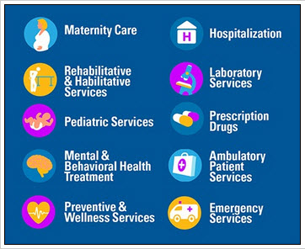
Essential Health Benefits
Florida did not participate in the process set up by HHS in for selection of an initial EHB package in 2013, and instead defaulted to the benefit package produced by the generic process established by HHS.
As a result, Florida Blue’s BlueOptions plan (i.e., the small group plan with the largest enrollment in Florida) became the starting point by default.
That benefits package was supplemented by federal officials to meet all ACA requirements.

Slide 4
Concerns With Current EHB Package
Lack of Monitoring Process
Florida’s Office of Insurance Regulation (OIR) as the official watchdog is problematic:
Is anyone watching?
If they are, are they punishing violators?
All evidence of the EHB’s effectiveness (or lack thereof) is anecdotal

Slide 5
Concerns With Current EHB Package
Definition of “Habilitative Services”
Habilitative services that “help a person learn, keep, or improve skills and functional abilities that they have never had,” as contrasted with rehabilitative services that help regain lost skills or functioning.
The benchmark plan selected by Florida did not include habilitative services and was not defined by the state itself.
Each insurer is therefore permitted to set its own definition of habilitative services.

Slide 6
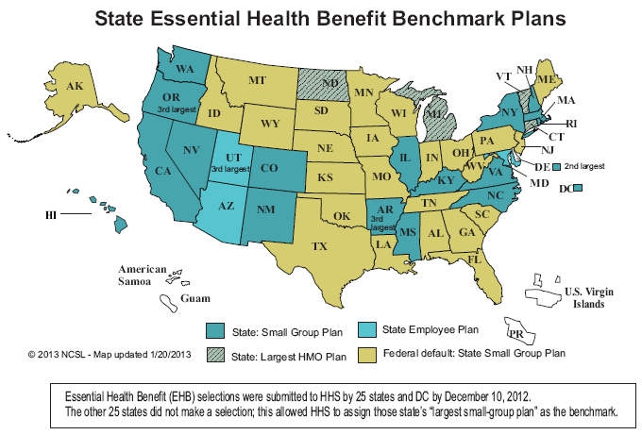
What’s Next?
We believe that active participation in the next opportunity to craft and implement Florida-specific recommendations regarding the EHB package would both benefit Florida consumers and strengthen Florida’s health insurance markets.
As consumer advocates, our strategy is to take any opportunity to insert ourselves in the process for the next round.

Slide 7
Florida Health Insurance Advisory Board
A Seat at the Table
Florida CHAIN is appointed to the FHIAB and is the only consumer advocacy group on the Board; chaired by Florida’s Insurance Commissioner Kevin McCarty.
We are able to fully participate on all proceedings of the public meetings; attended by press and televised.
Recently, there has been more responsiveness, communication and more “air time” for us on the agenda.

Slide 8
Essential Health Benefits
Plan Setting
In August, more than two dozen organizations signed on to a letter to the Insurance Commissioner; it was presented publicly at the FHIAB meeting.
Signers included children’s organizations, disease groups, disability organizations etc.
The letter requested that the Commissioner:
Convene a workgroup to review the issue of Florida’s EHB package and make recommendations
Schedule a series of public hearings for stakeholders and providers to provide public input as to the current EHB package, how consumers are benefitting and where the gaps are .
The goal is to develop recommendations on how the EHB package can be improved with consumer input.

Slide 9
Essential Health Benefits
Plan Setting
OIR would pick a benchmark plan from among 10 options (would then need to be supplemented to meet federal requirements and state preferences).
The step before any of that decision-making, however, would hopefully be OIR background research and public hearings to react to issues and concerns with the current EHB package.
Advocates are striving to ensure that we have more of an opportunity to provide public input than solely providing written comments, which is a route they could take.

Slide 10
Where Are We Are?
The letter wasn’t met with overwhelming support at first but the reaction was less hostile and more encouraging than we expected.
Commissioner McCarty followed up with Florida CHAIN, interested in allowing the Advisory board to vote on the possibility of a public hearing.
We have not heard as to whether a working group will be considered.
A vote will be taken by the FHIAB in February regarding the hearings – STAY TUNED!

Slide 11
Where Are We Now? Proposed Rules by HHS
In November 2014, HHS proposed several EHB rule changes, which momentarily gave Florida’s OIR some pause before moving forward.
Under the proposed rule, states will once again have the opportunity to select a benchmark, this time from 2014 plans. (Effective 2017 plan year)
We have some concerns that OIR may delay because there is more time than previously thought to make the selection but we are making the case for spending the time wisely!
We are reaching out to Florida’s disease groups, children’s organizations, disability organizations and others in preparation of the hearings to ensure participation if approved.
Notes:
The federal definition would only be used when a benchmark plan does not include coverage for habilitation services and would encompass “health care services that help a person keep, learn, or improve skills and functioning for daily living.” While this may leave some uncertainty as to exactly which services must be covered, it seems like an improvement over the current approach, which in some states allows insurers to set their own definition for habilitation services.

Slide 12
THANK YOU!
leah@floridachain.org
www.floridachain.org
www.healthcareforflorida.org
www.kidswellflorida.org
#HealthFLNow
FloridaCHAIN
#FLCHAIN
Notes:
The federal definition would only be used when a benchmark plan does not include coverage for habilitation services and would encompass “health care services that help a person keep, learn, or improve skills and functioning for daily living.” While this may leave some uncertainty as to exactly which services must be covered, it seems like an improvement over the current approach, which in some states allows insurers to set their own definition for habilitation services.

